Slide 1
Chapter 7
Parameter Estimation Using the Sample Mean
Chapter 10 of 3rd ed.
Chien-Kang Huang (黃乾綱)
臺大工科海洋系

Slide 2
Outline
7.1 Sample Mean: Expected Value and Variance (10.1)
7.2 Deviation of a Random Variable from the Expected Value (10.2)
7.3 Point Estimates of Model Parameters (10.4)
7.4 Confidence Intervals

Slide 3
In referring to applications of probability theory, we have assumed prior knowledge of the probability model that governs the outcomes of an experiment.
In practice, however, we encounter many situations in which the probability model is not know in advance and experimenters collect data in order to learn about the model.
In doing so, they apply principles of statistical inference, a body of knowledge that governs the use of measurements to discover the properties of a probability model.
Sample mean of a set of data
  The sample mean is simply the sum of the sample values divided by the number of trials.

Slide 4
7.1 Sample Mean: Expected Value and Variance

Slide 5
  In this section, we define the sample mean of a random variable and identify its expected value and variance. Later sections of this chapter show mathematically how the sample mean converges to a constant as the number of repetitions of an experiment increases. This chapter, therefore, provides the mathematical basis for the statement that although the result of a single experiment is unpredictable, predictable patterns emerge as we collect more and more data.
To define the sample mean, consider repeated independent trials of an experiment. Each trial results in one observation of a random variable, X. After n trials, we have sample values of the n random variables X₁, …, X_{n}, all with the same PDF as X. The sample mean is the numerical average of the observations:

Slide 6
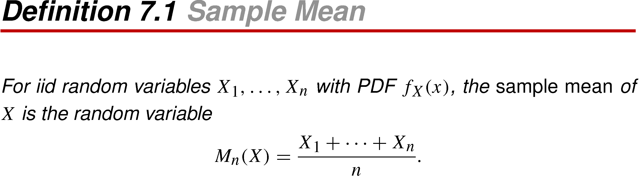
Definition 7.1 Sample Mean

Slide 7
The first thing to notice is that M_{n}(X) is a function of the random variables X₁, …, X_{n}, and is therefore a random variable itself.
It is important to distinguish the sample mean M_{n}(X), from E[X], which we sometimes refer to as the mean value of random variable X. While M_{n}(X) is a random variable, E[X] is a number.
To avoid confusion when studying the sample mean, it is advisable to refer to E[X] as the expected value of X, rather than the mean of X. The sample mean of X and the expected value of X are closely related.
A major purpose of this chapter is to explore the fact that as n increases without bound, M_{n}(X) predictably approaches E[X]. In everyday conversation, this phenomenon is often called the law of averages.

Slide 8
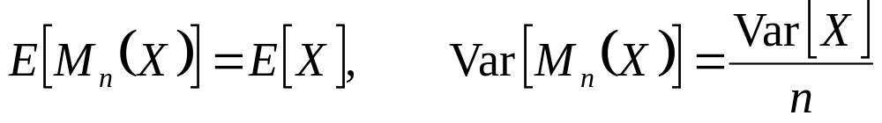
Theorem 7.1
The sample M_{n}(X) has expected value and Variance

Slide 9
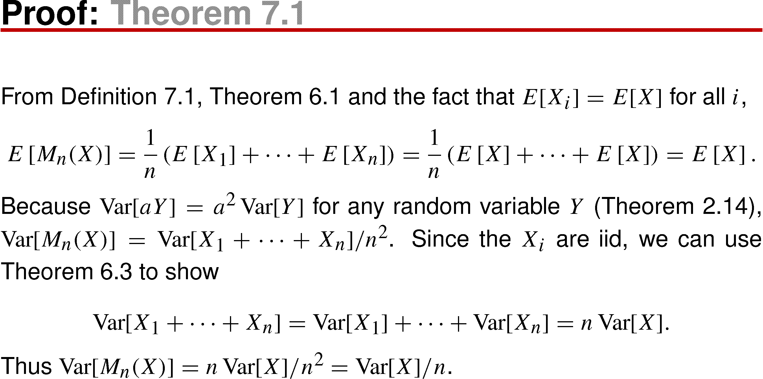
Theorem 7.1 Proof

Slide 10
Recall that in Section 2.5, we refer to the expected value of a random variable as a typical value. Theorem 7.1 demonstrates that E[X] is a typical value of M_{n}(X), regardless of n. Furthermore, Theorem 7.1 demonstrates that as n increases without bound, the variance of M_{n}(X) goes to zero.
  When we first met the variance, and its square root the standard deviation, we said that they indicate how far a random variable is likely to be form its expected value.
Theorem 7.1 suggests that as n approaches infinity, it becomes highly likely that converges to the expected value as the number of sample n goes to infinity.
The rest of this chapter contains the mathematically analysis that describes the nature of this convergence.

Slide 11
Quiz 7.1
Let X be an exponential random variable with expected value 1. Let M_{n}(X) denote the sample mean of n independent samples of X. How many samples n are needed to guarantee that the variance of the sample mean is no more than 0.01.

Slide 12
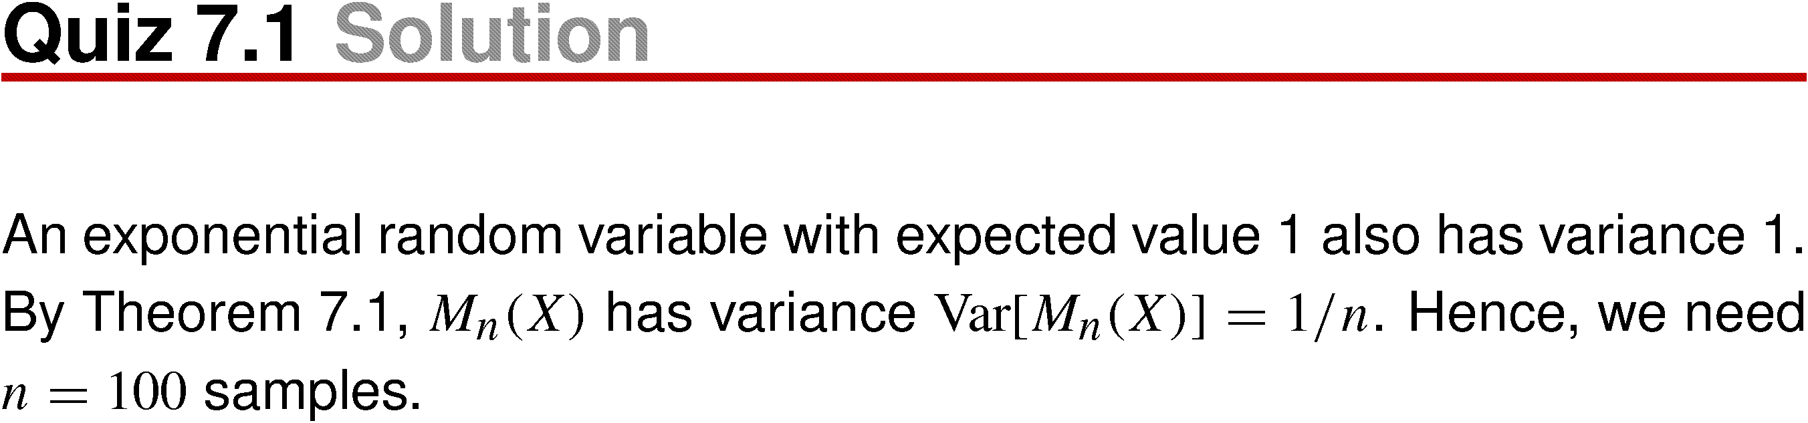
Quiz 7.1 Solution

Slide 13
7.2 Deviation of a Random Variable from the Expected Value

Slide 14
The analysis of the convergence of M_{n}(X) to E[X] begins with a study of the random variable |Y – μ_{Y}|, the absolute different between an arbitrary random variable Y and its expected value. This study leads to the Chebyshev inequality, which states that the probability of a large deviation from the mean is inversely proportional to the square of the deviation. The deviation of the Chebyshev inequality begins with the Markov inequality, an upper bound on the probability that a sample value of a nonnegative random variable exceeds the expected value by an arbitrary factor.

Slide 15
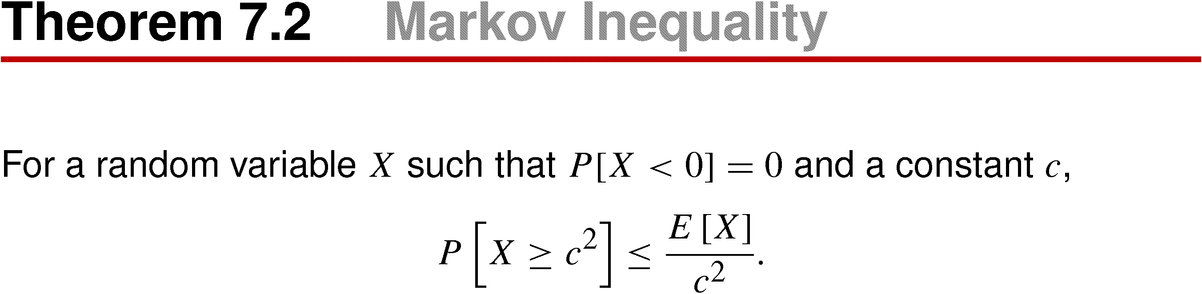
Theorem 7.2 Markov Inequality

Slide 16
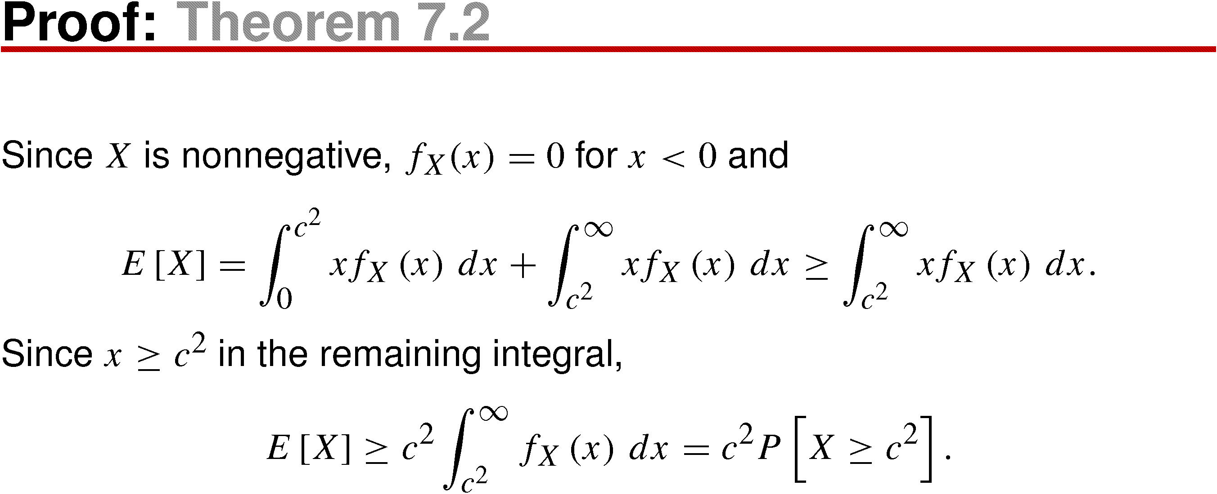
Theorem 7.2 Proof
Keep in mind that the Markov inequality is valid only for nonnegative random variables.
The bound provided by the Markov inequality can be very loose.

Slide 17
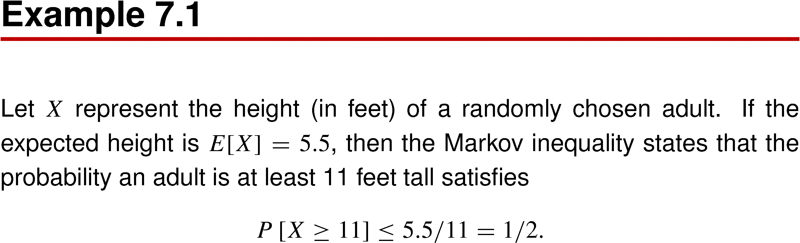
Example 7.1
We say the Markov inequality is a loose bound because the probability that a person is taller than 11 feet is essentially zero, while the inequality merely states that it is less than or equal to 1/2. Although the bound is extremely loose for many random variables, it is tight (in fact, an equation) with respect to some random variables.

Slide 18
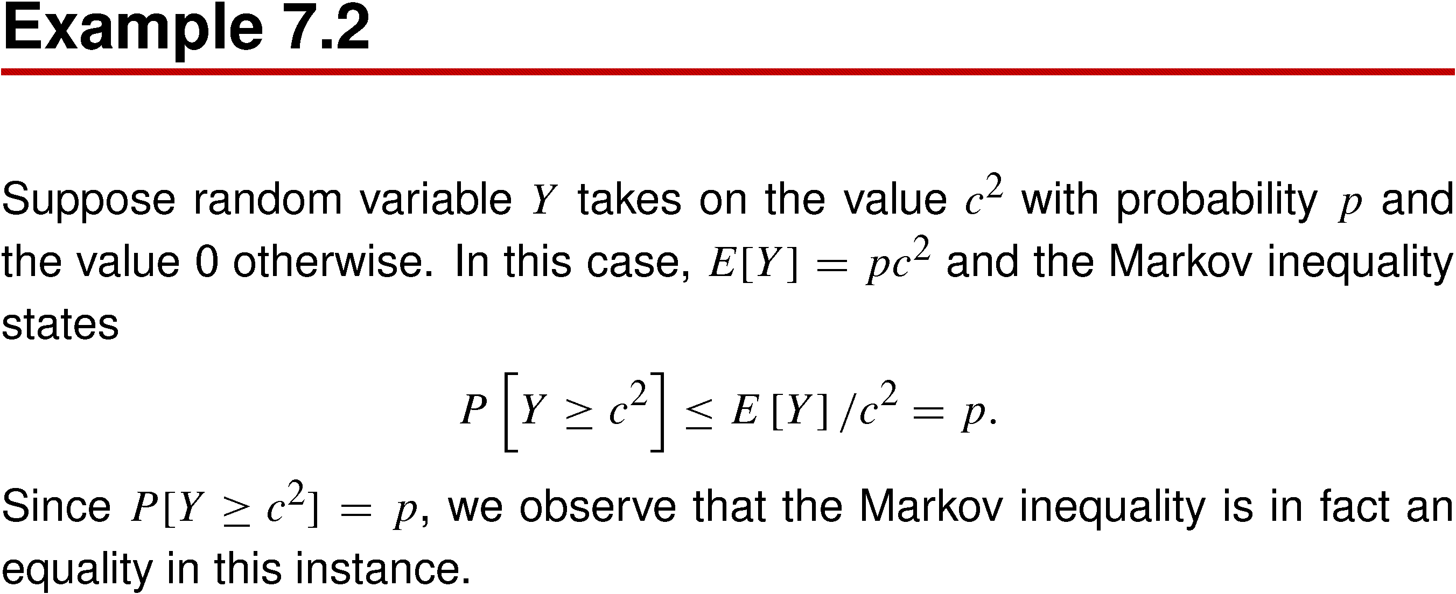
Example 7.2

Slide 19
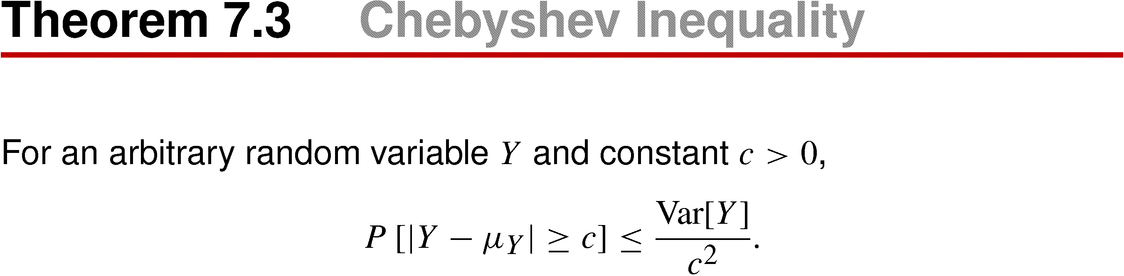
Theorem 7.3
The Chebyshev inequality applies the Marko inequality to the nonnegative random variable (Y – μ_{Y})², derived from any random variable Y.

Slide 20
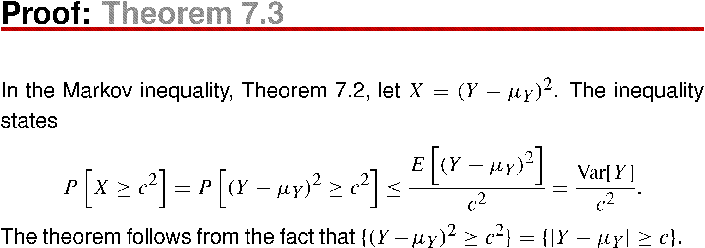
Theorem 7.3 Proof

Slide 21
Unlike the Markov inequality, the Chebyshev inequality is valid for all random variables.
While the Markov inequality refers only to the expected value of a random variable, the Chebyshev inequality also refers to the variance. Because it uses more information about the random variable, the Chebyshev inequality generally provides a tighter bound than the Markov inequality.
In particular, when the variance of Y is very small, the Chebyshev inequality says it is unlikely that Y is far away from E[Y].

Slide 22
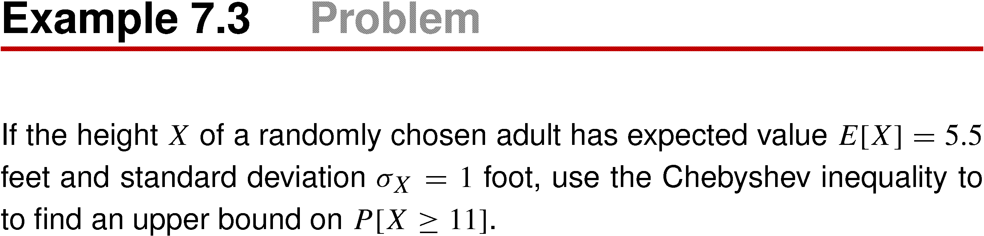
Example 7.3

Slide 23
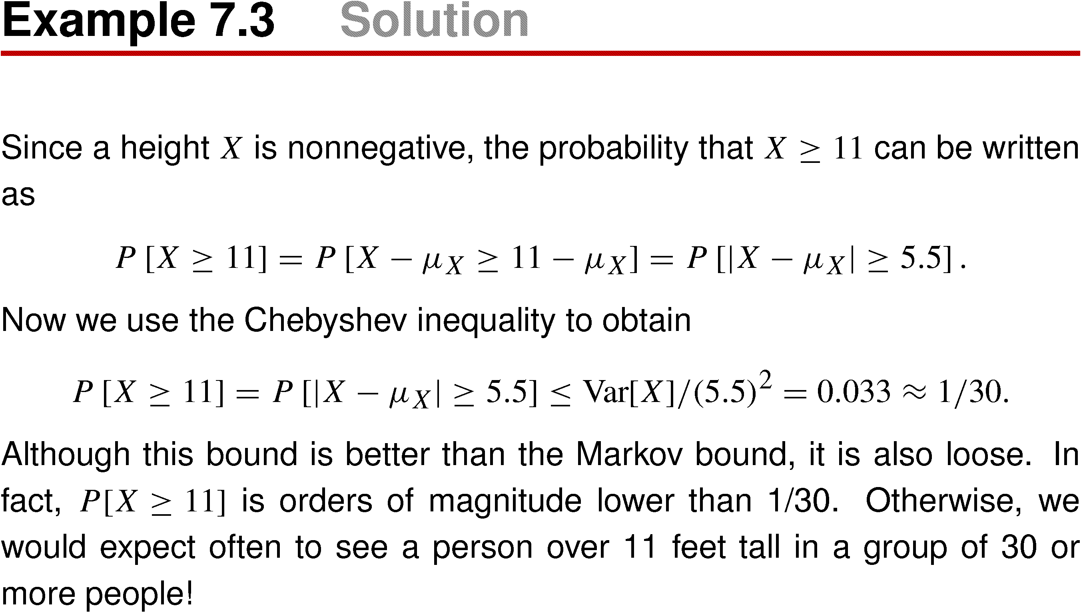
Example 7.3 Solution

Slide 24
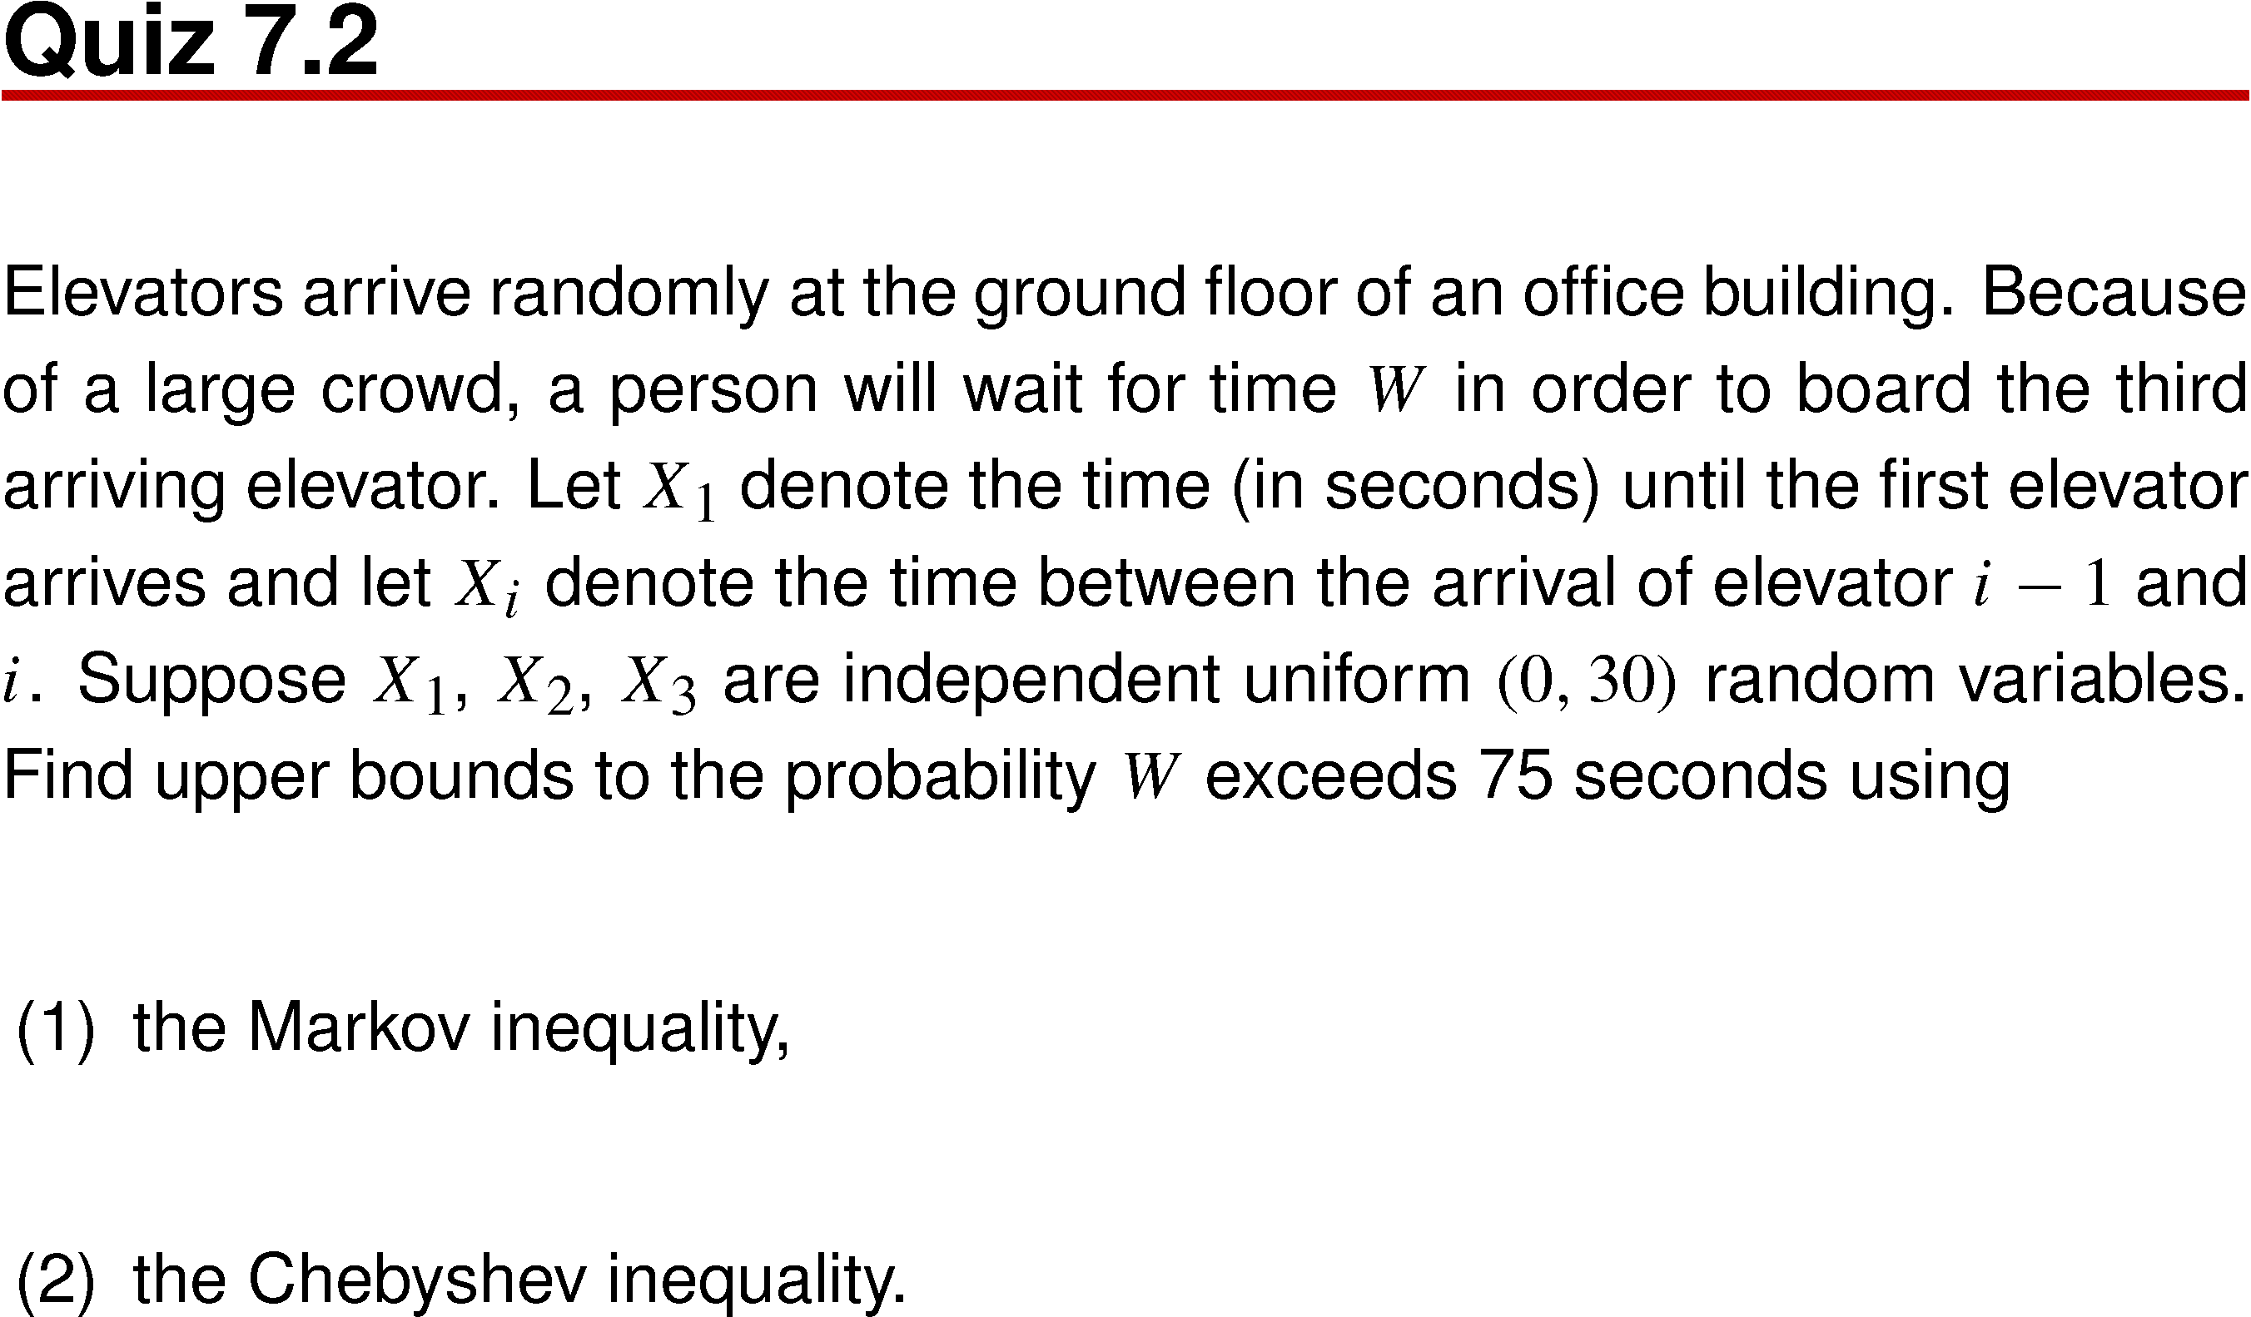
Quiz 7.2

Slide 25
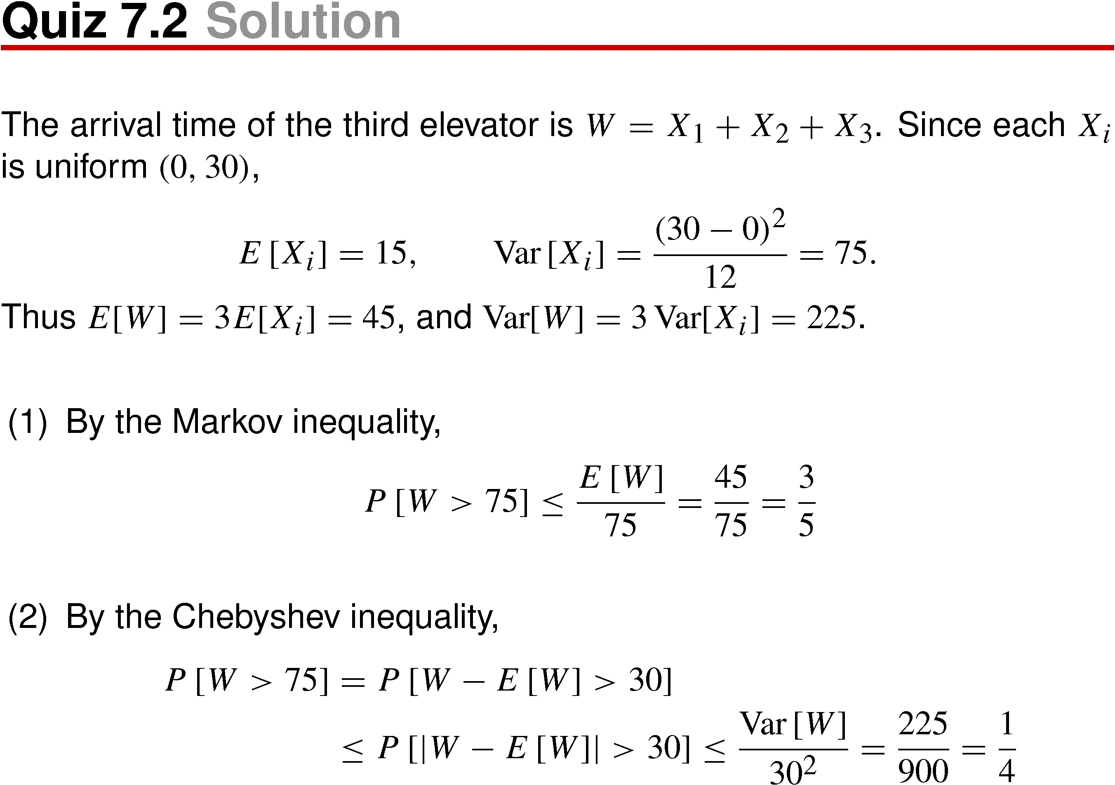
Quiz 7.2 Solution

Slide 26
7.3 Point Estimates of Model Parameters

Slide 27
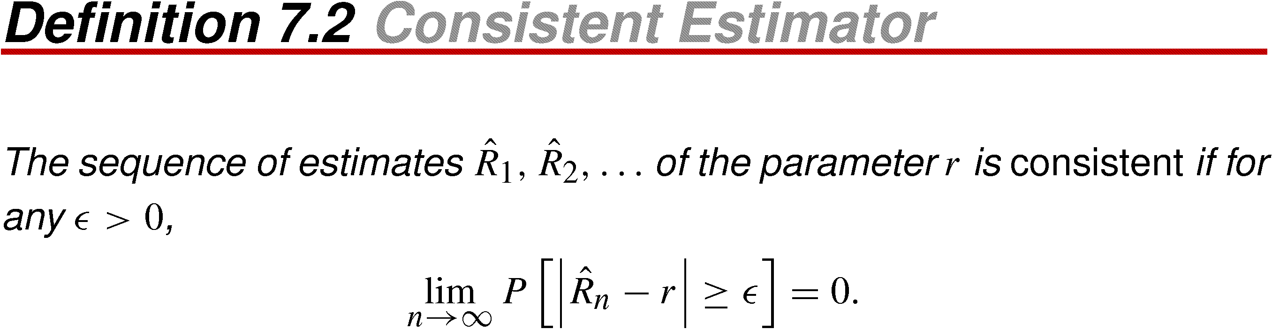
Definition 7.2 Consistent Estimator

Slide 28
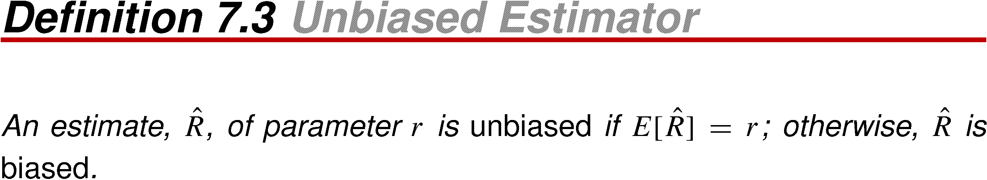
Definition 7.3 Unbiased Estimator

Slide 29
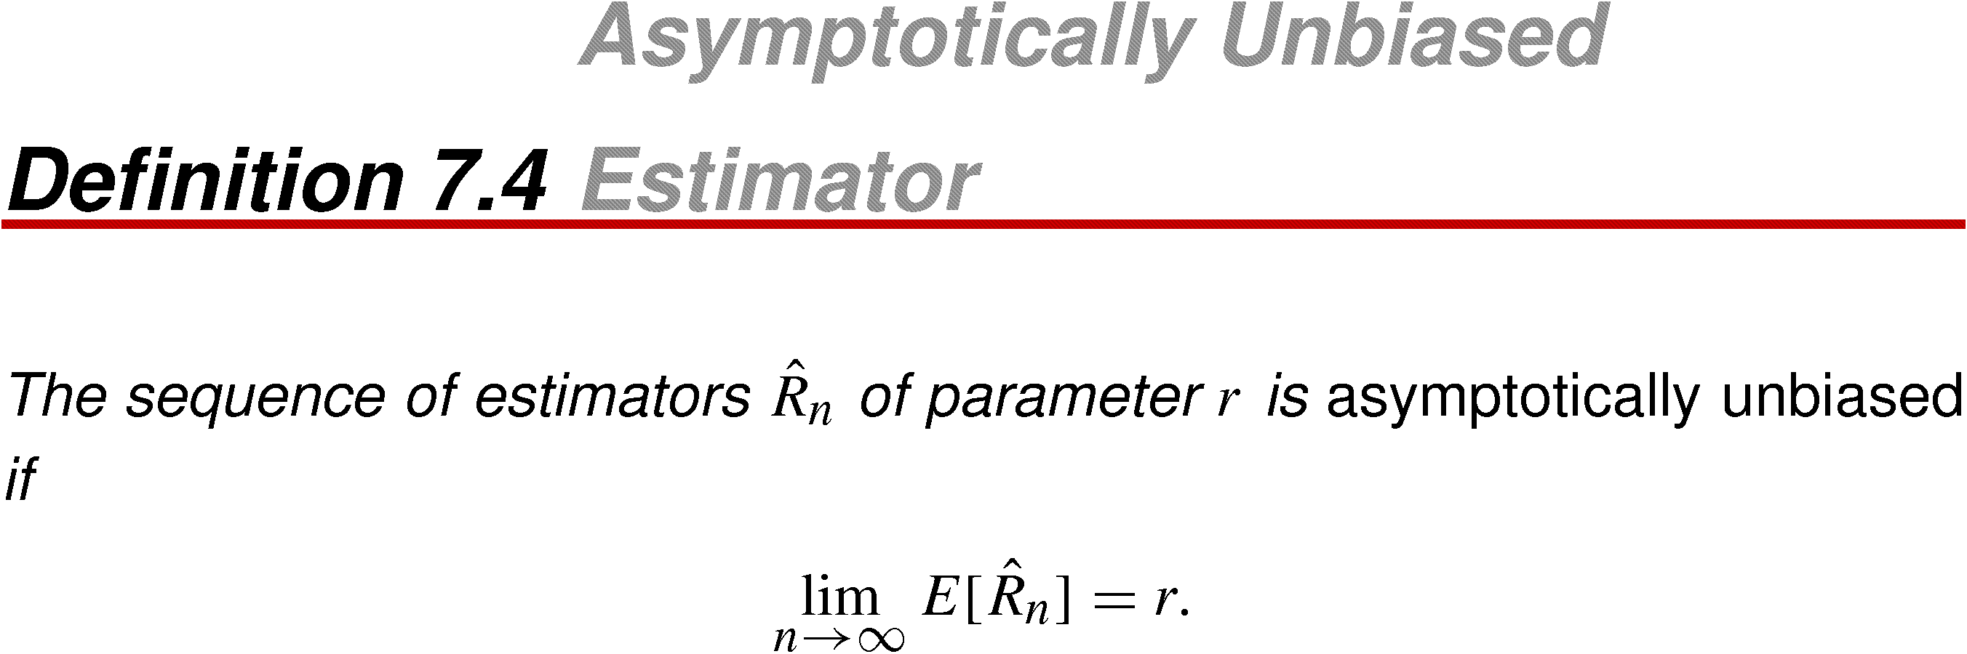
Definition 7.4 Asymptotically Unbiased Estimator

Slide 30
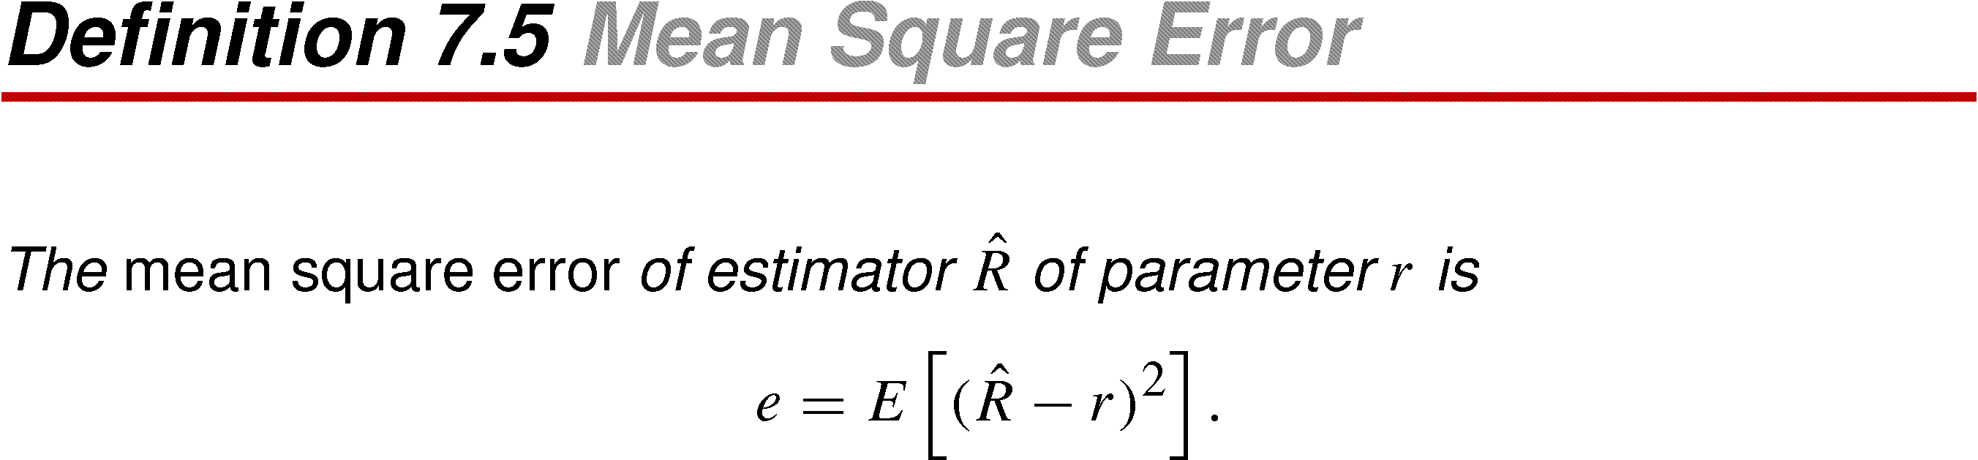
Definition 7.5 Mean Square Error

Slide 31
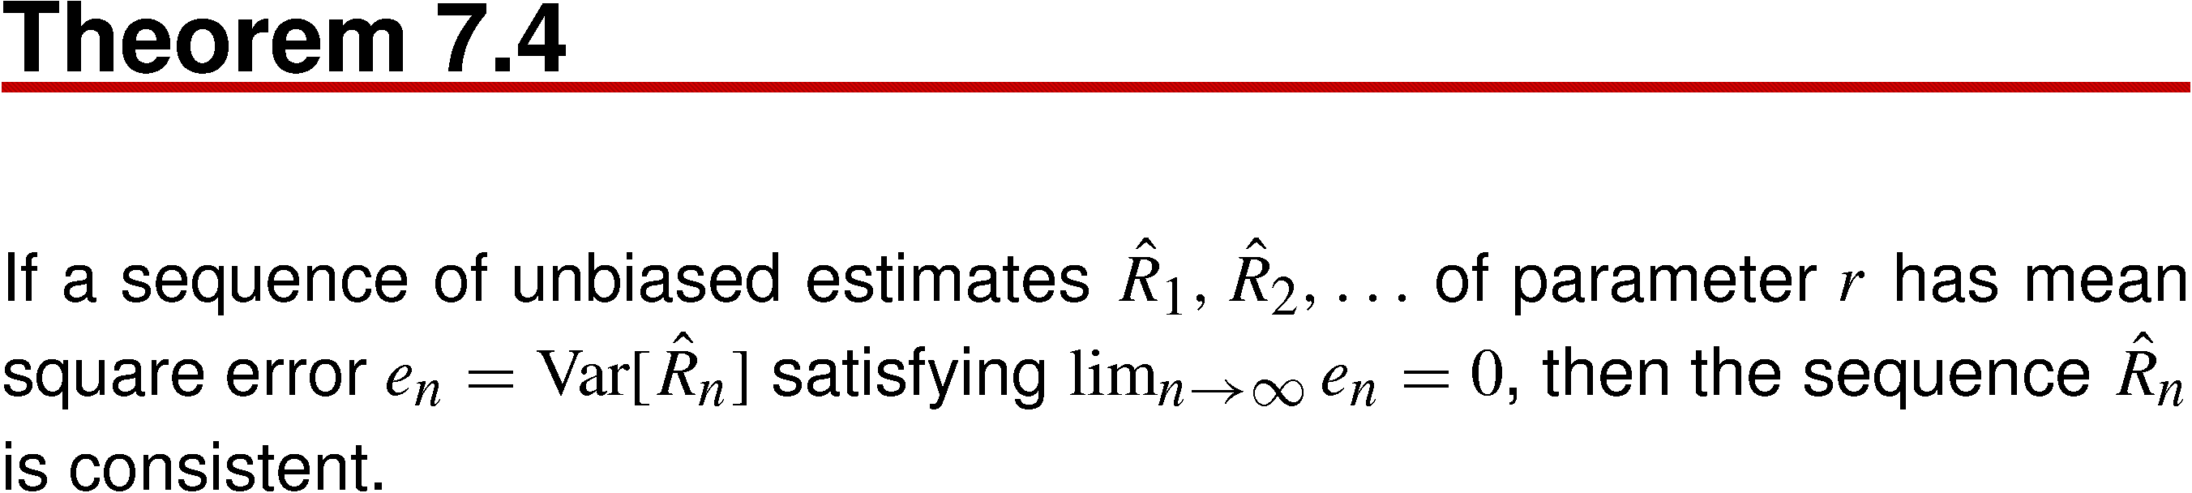
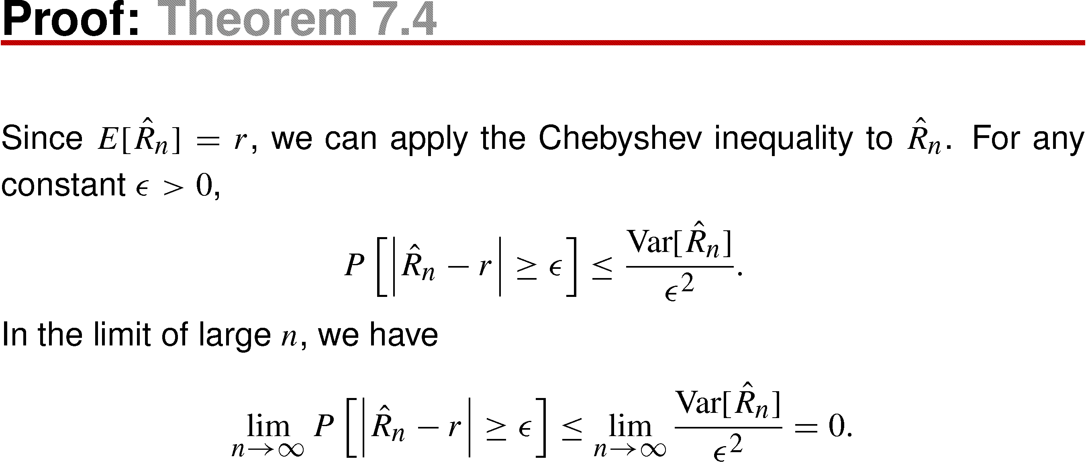
Theorem 7.4

Slide 32
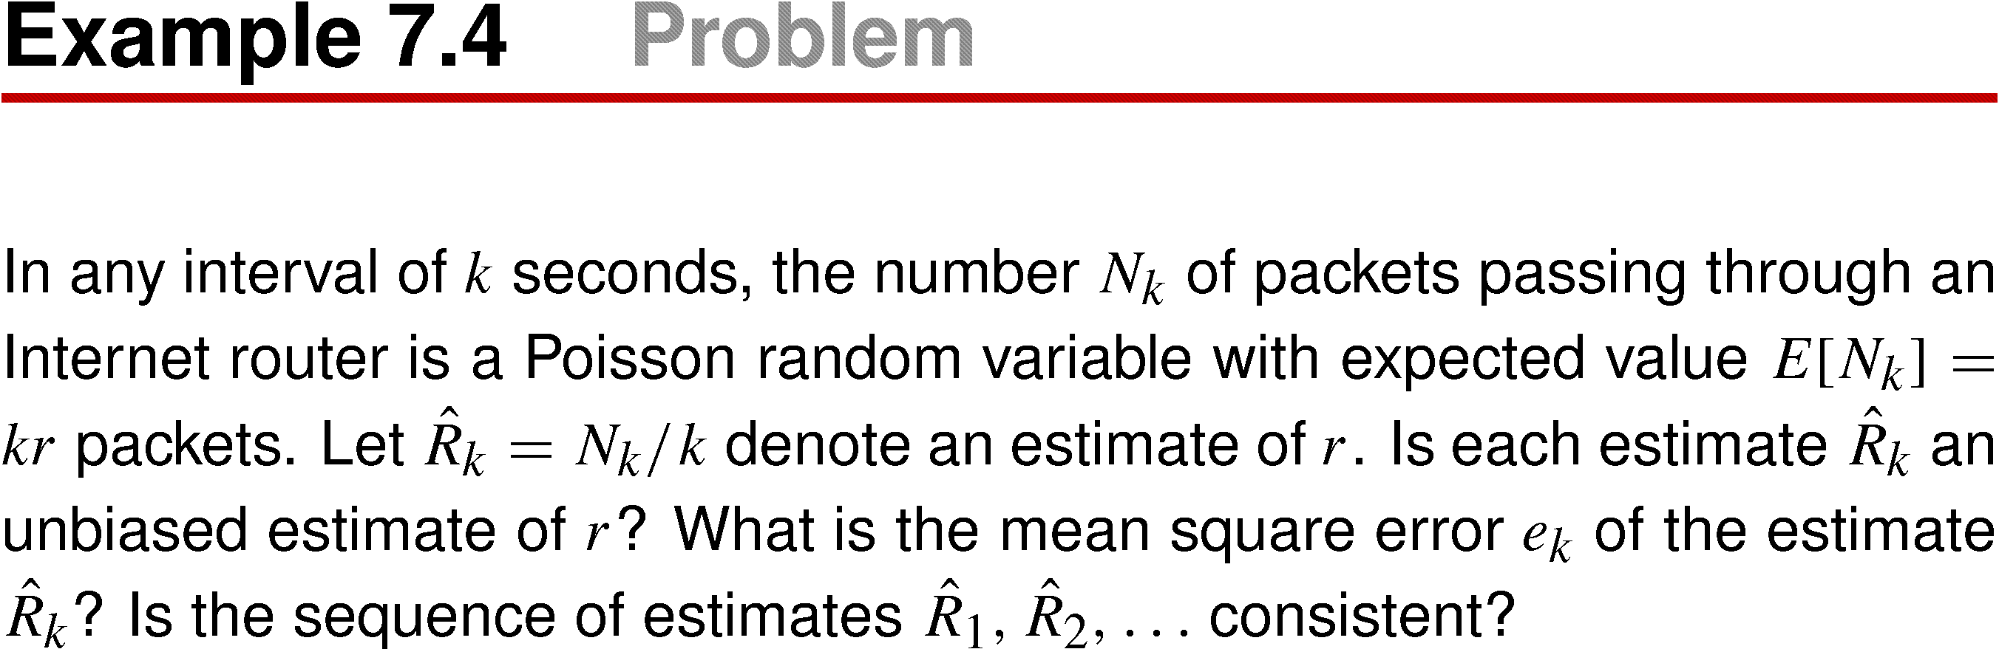
Example 7.4

Slide 33
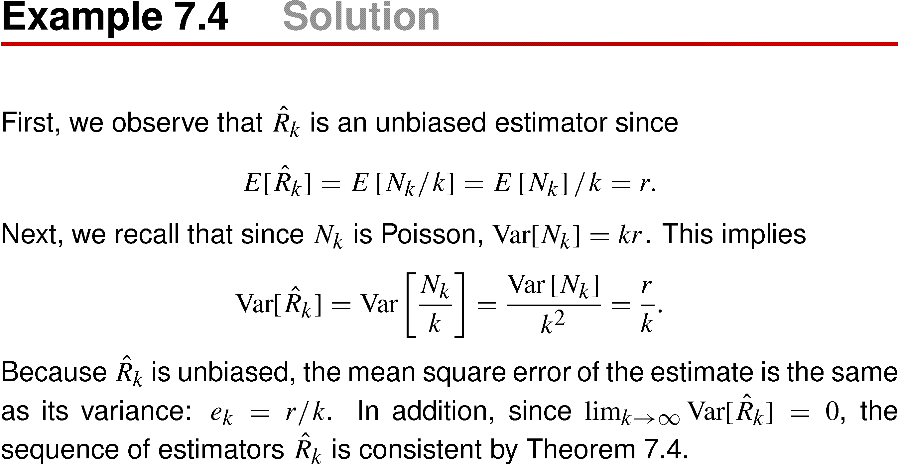
Example 7.4 Solution

Slide 34
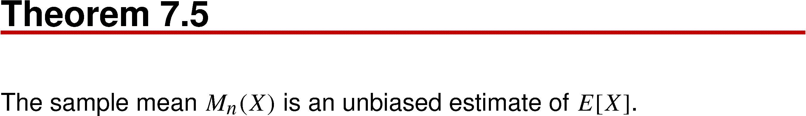
Theorem 7.5

Slide 35
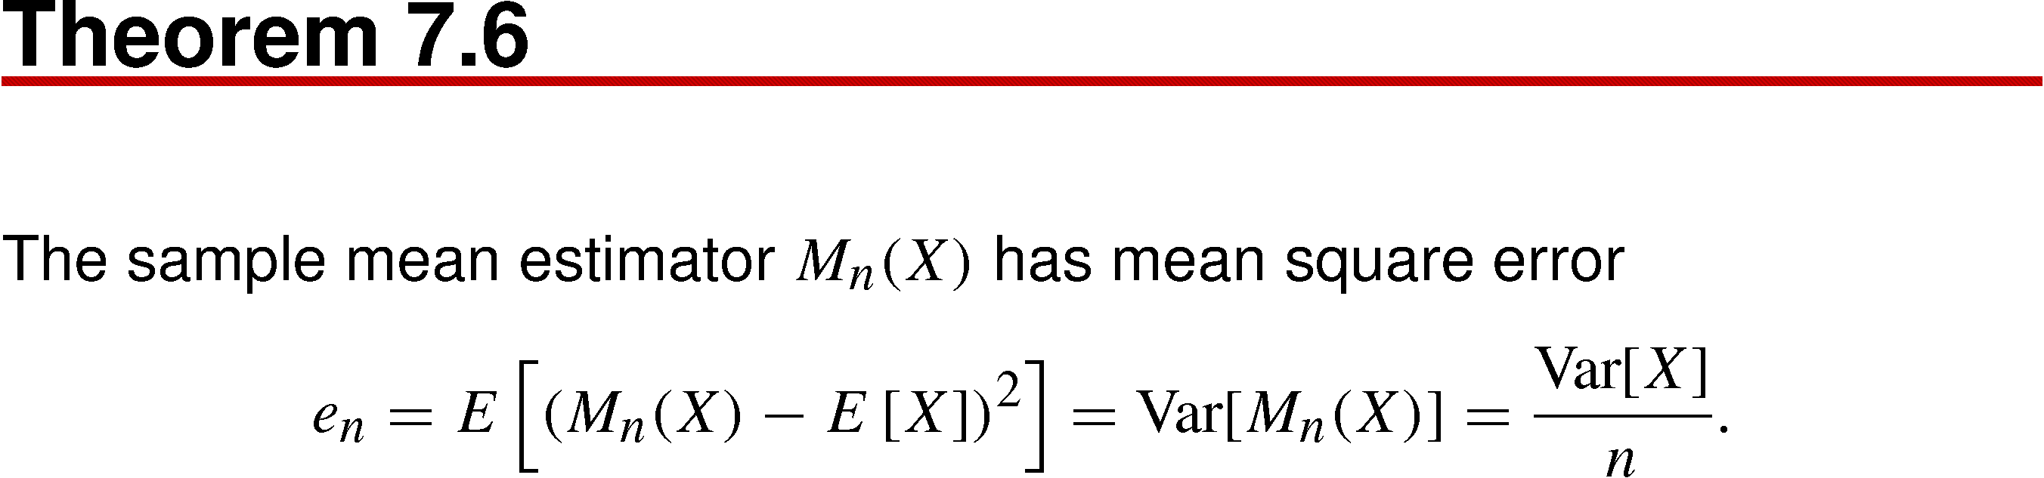
Theorem 7.6

Slide 36
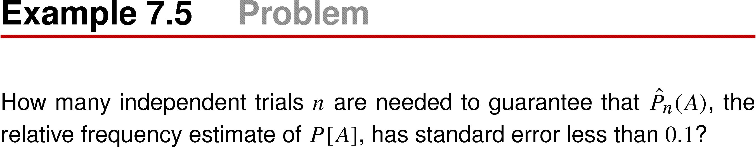
Example 7.5

Slide 37
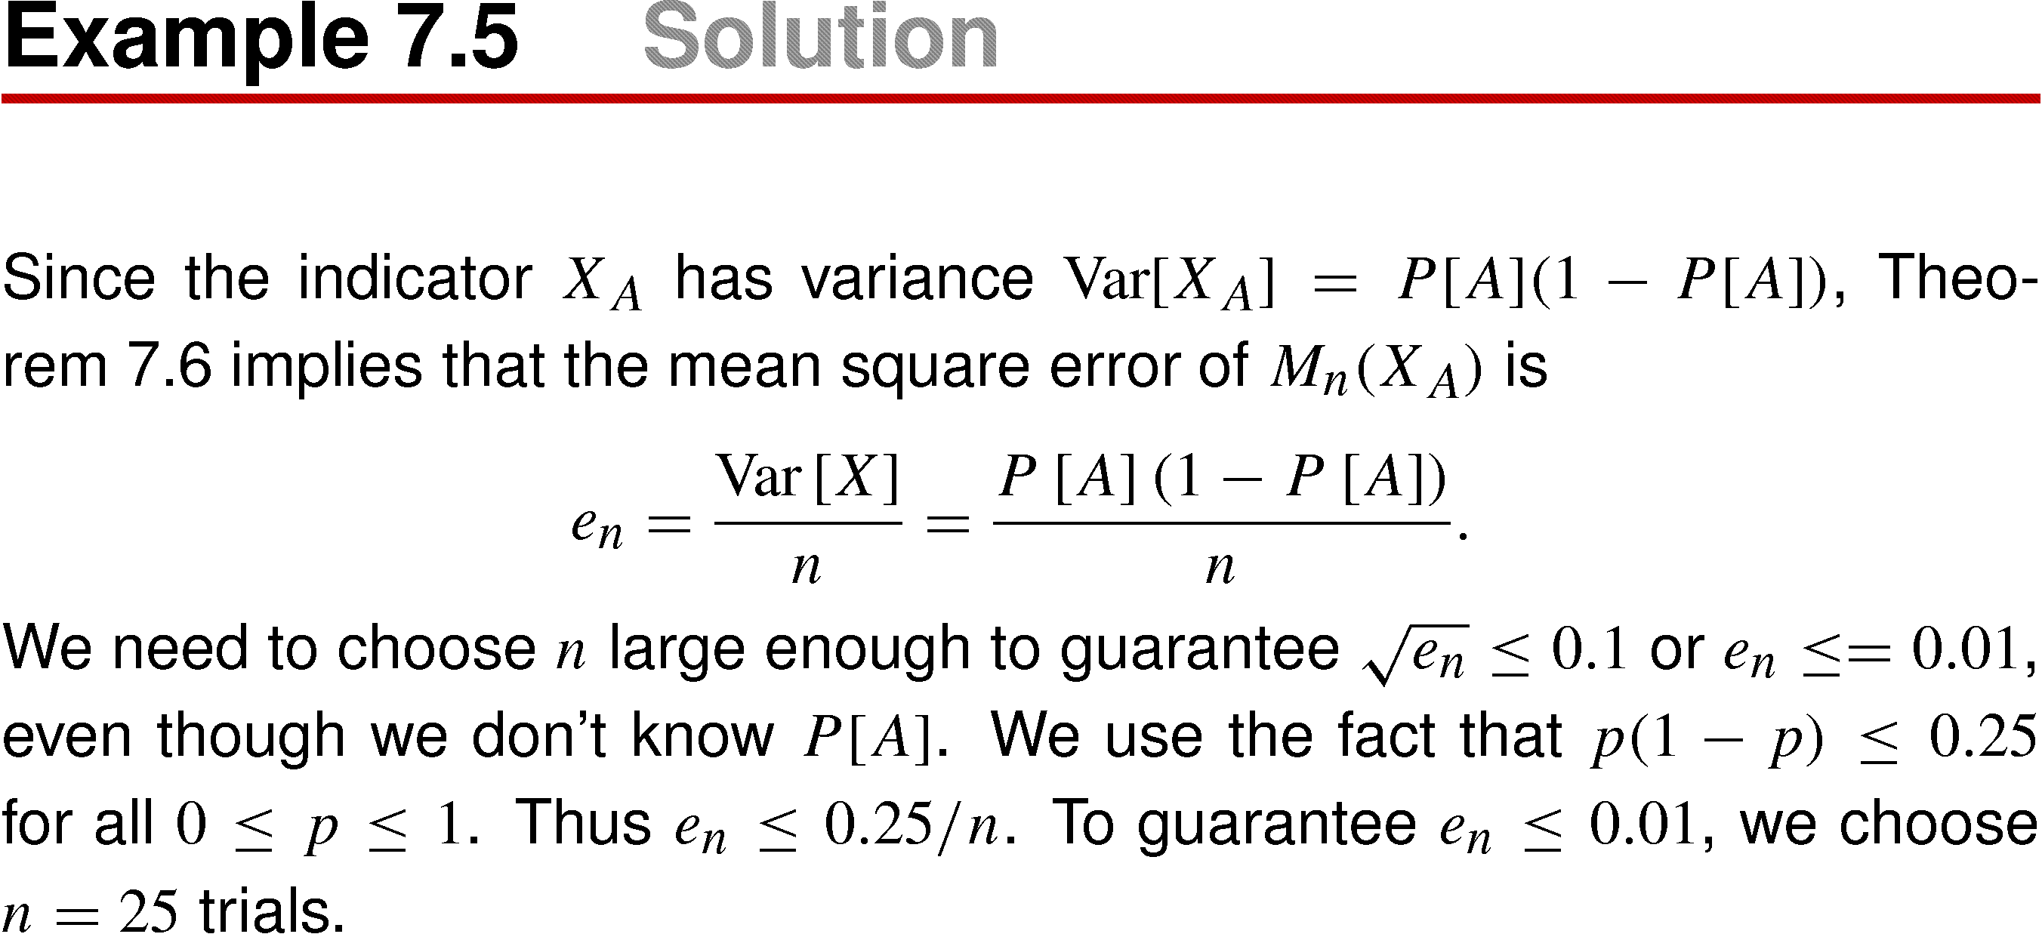
Example 7.5 Solution

Slide 38
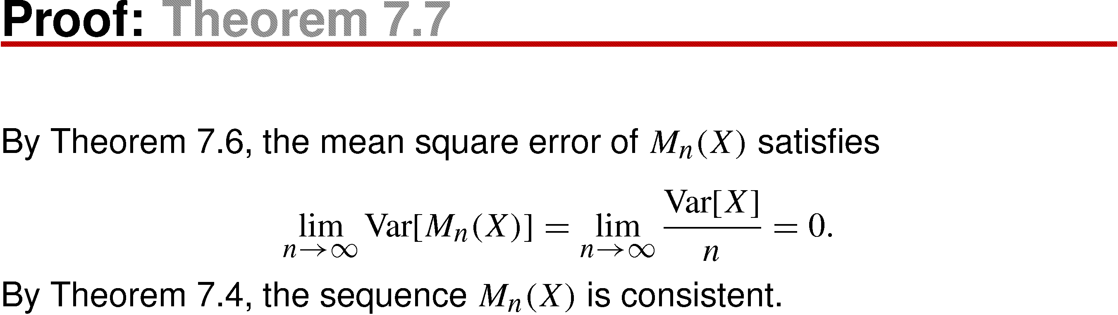
Theorem 7.7
If X has finite variance, then the sample mean is a sequence of consistent estimates of E[X]

Slide 39
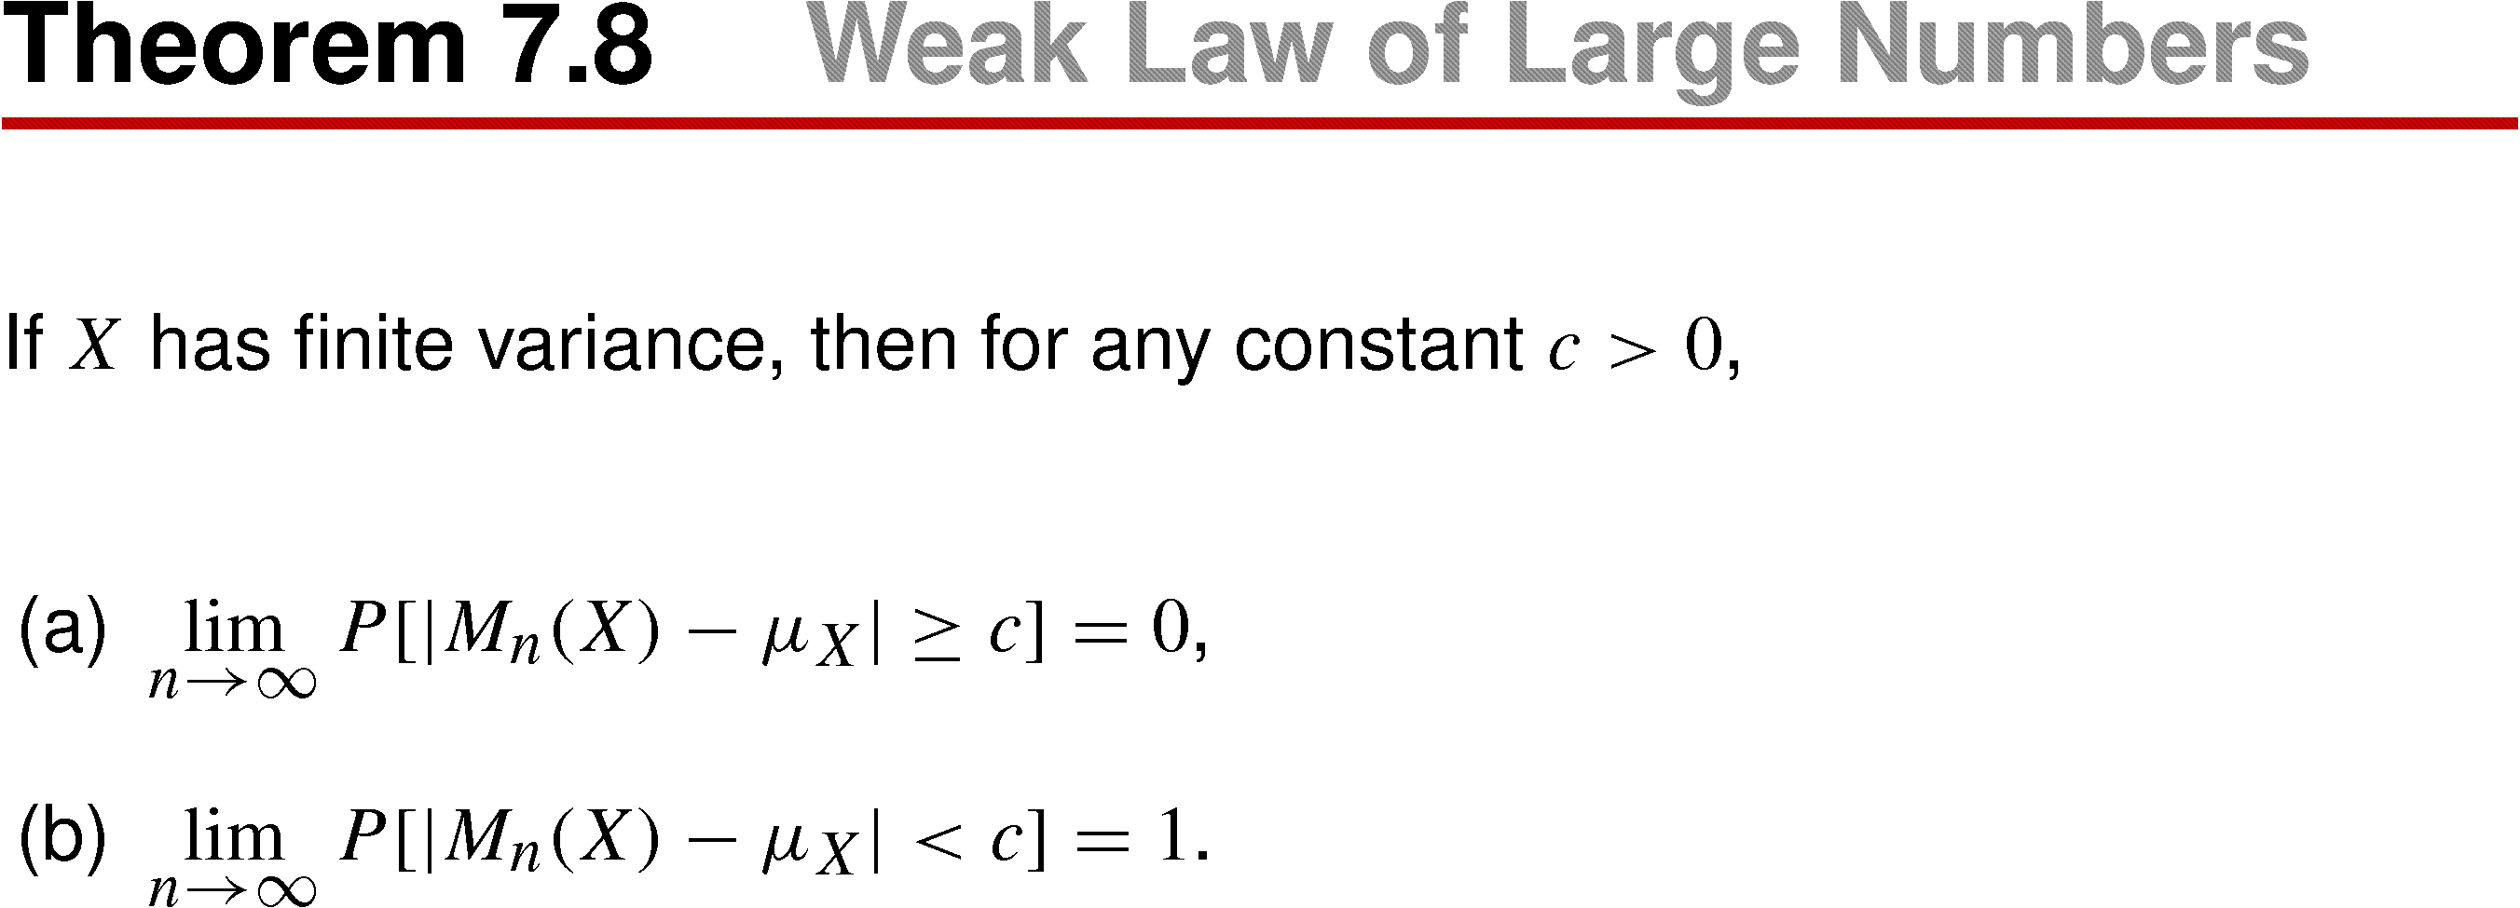
Theorem 7.8 Weak Law of Large Numbers

Slide 40
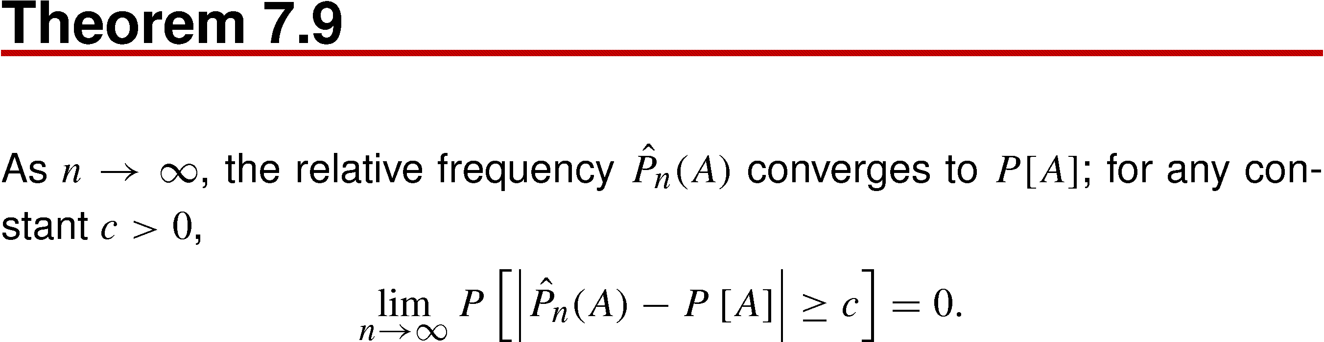
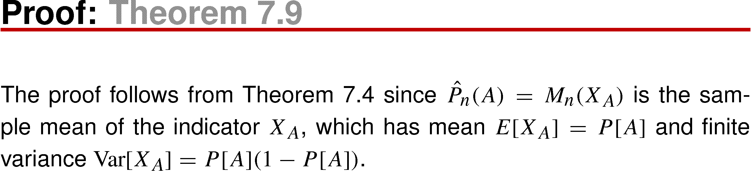
Theorem 7.9

Slide 41
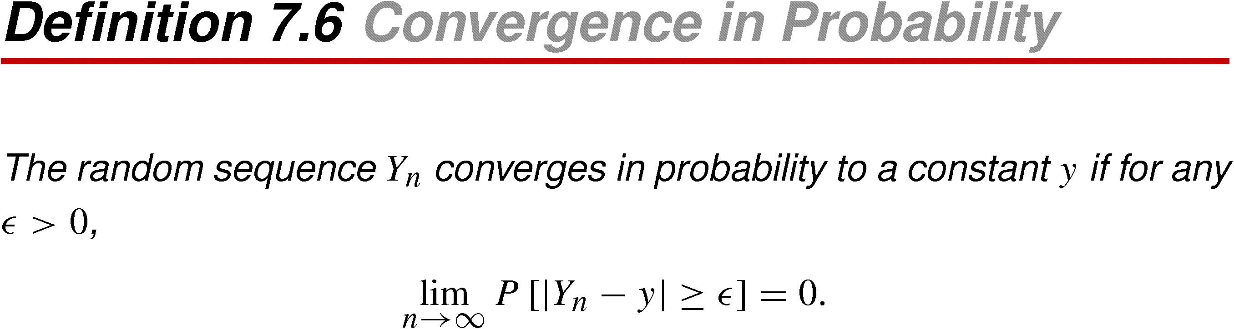
Definition 7.6 Convergence in Probability

Slide 42
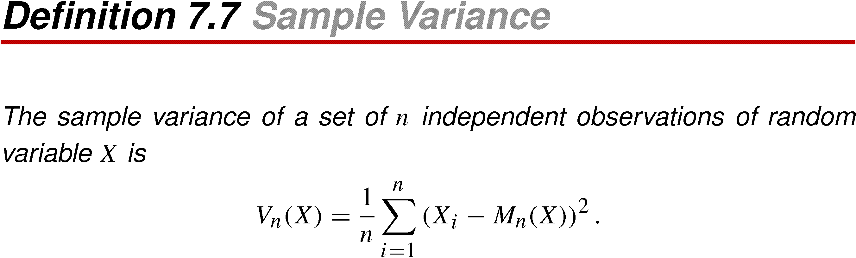
Definition 7.7 Sample Variance

Slide 43
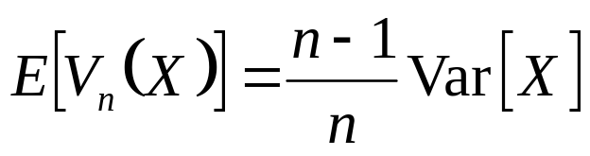
Theorem 7.10

Slide 44
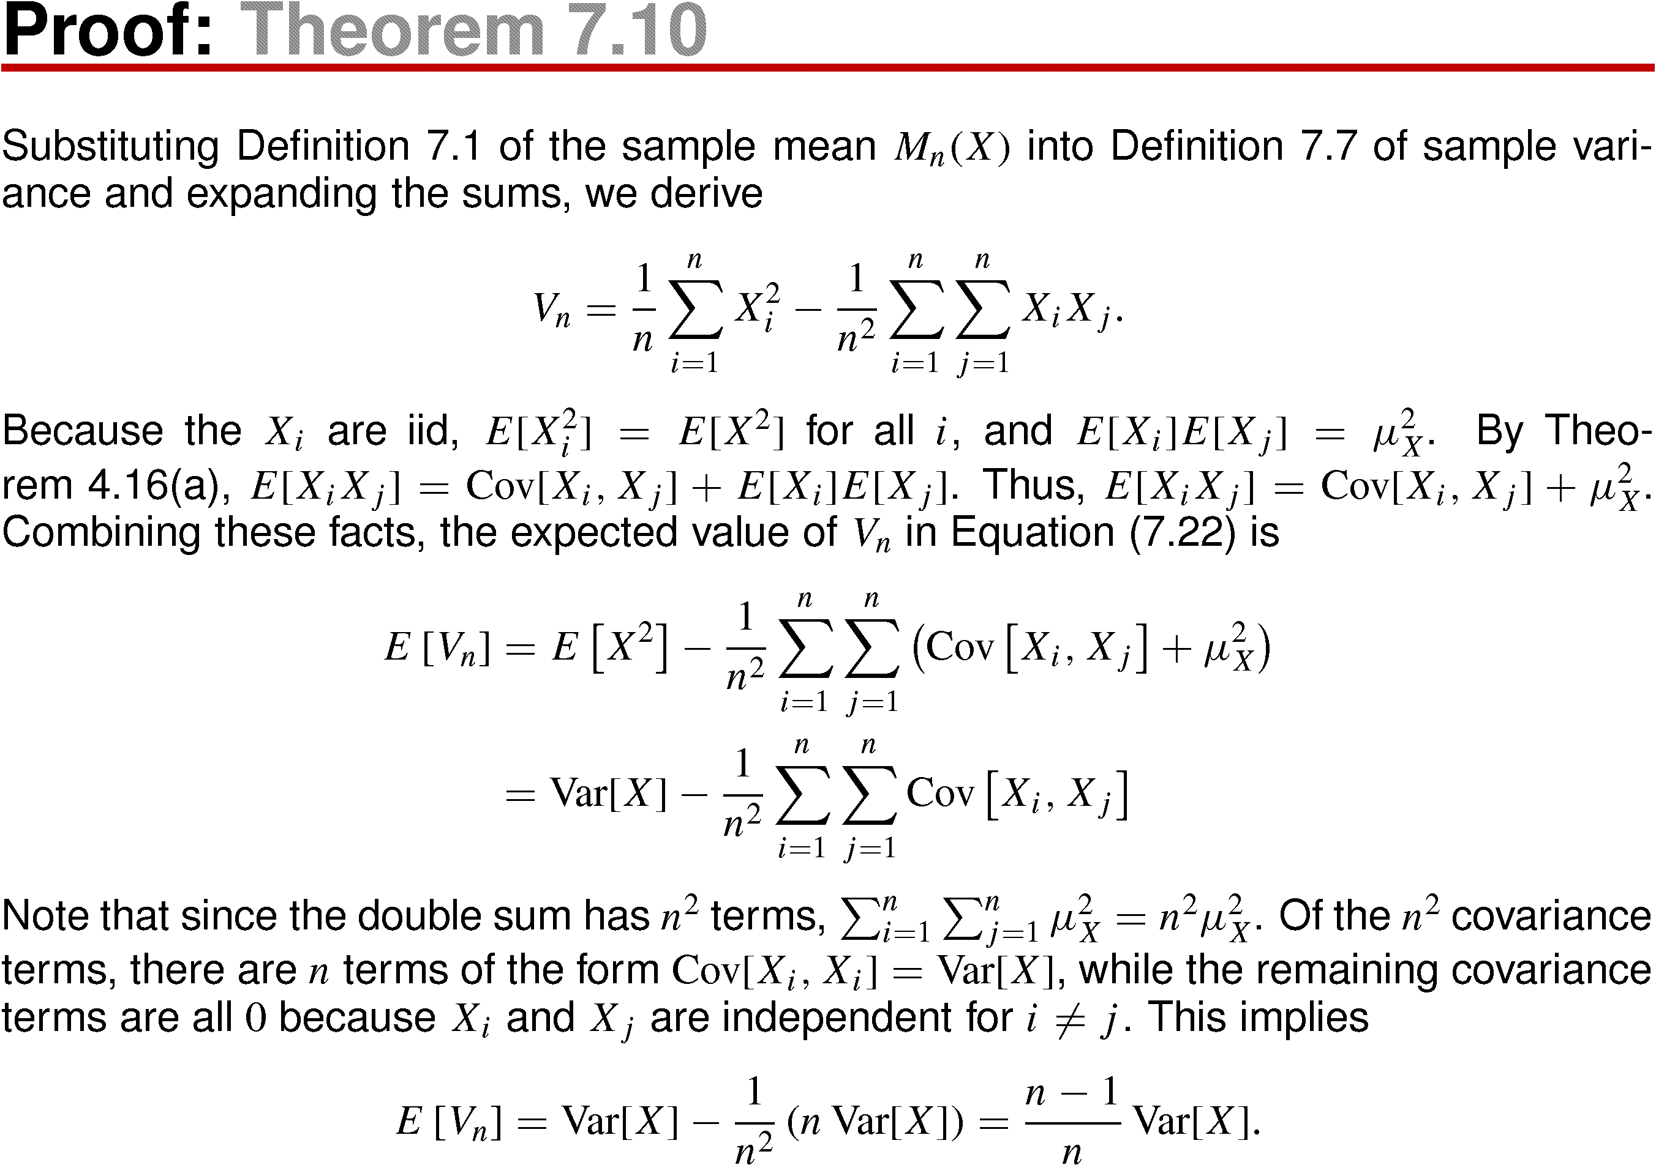
Theorem 7.10 Proof

Slide 45
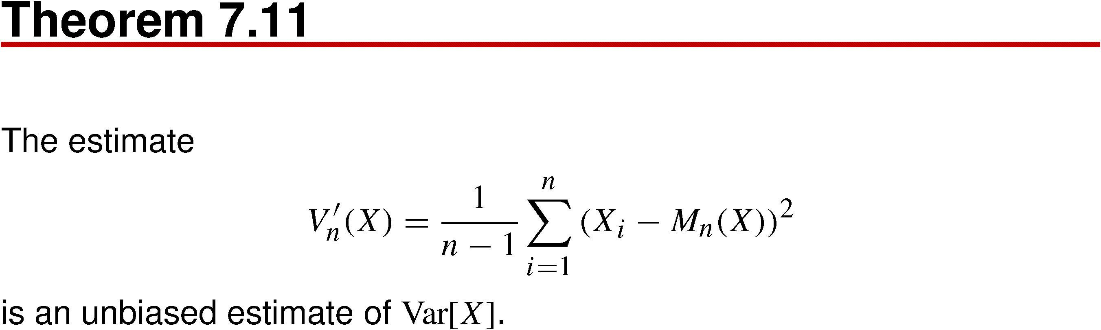
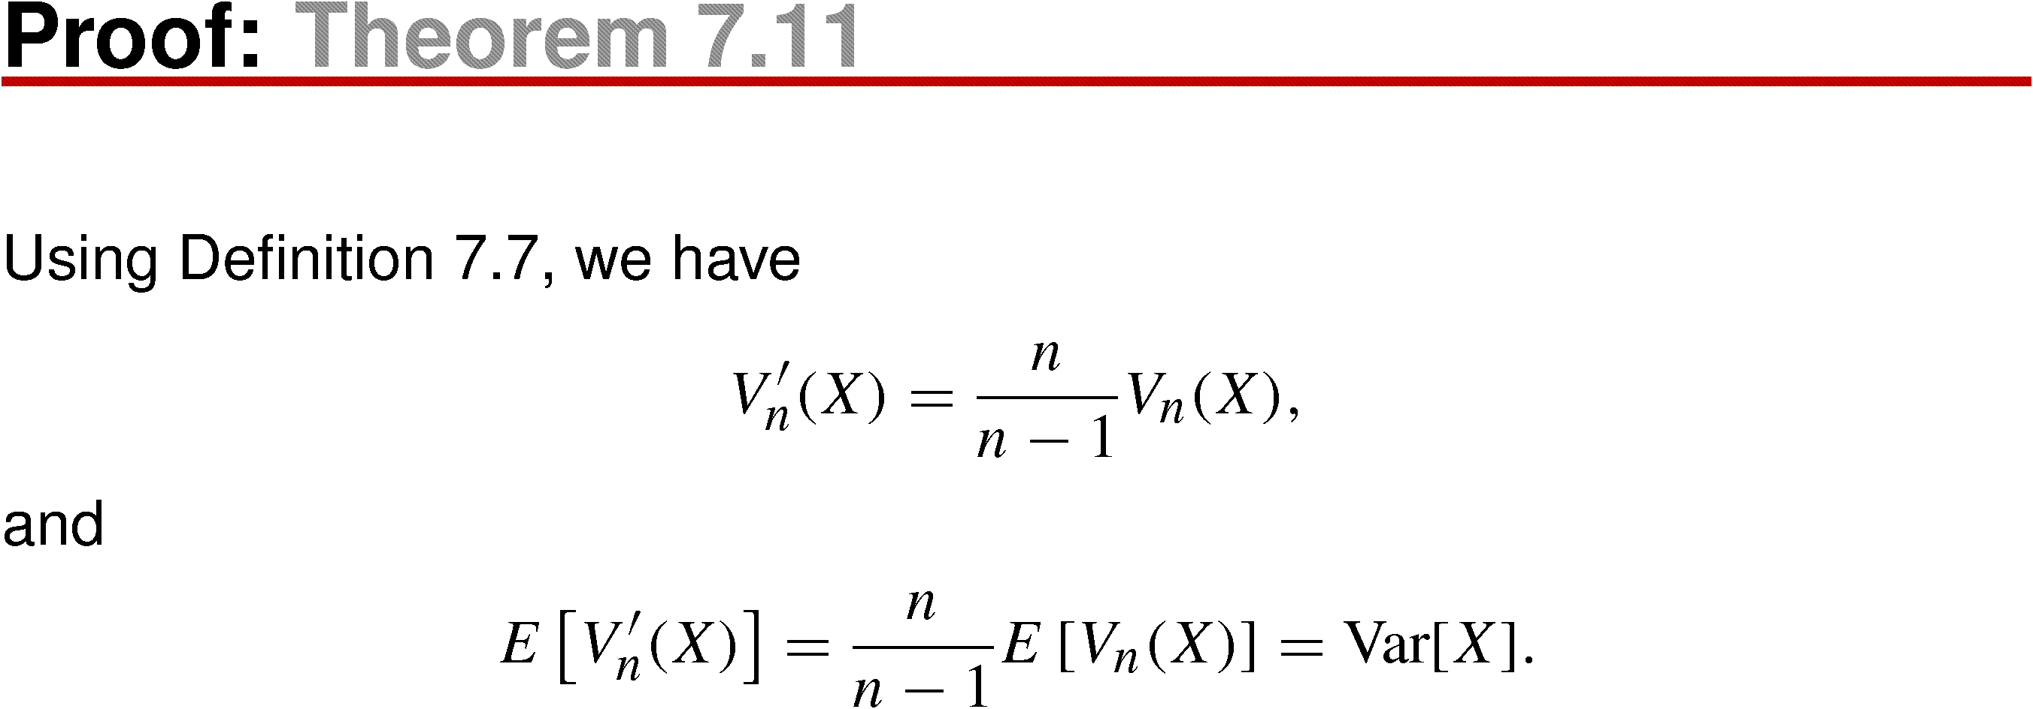
Theorem 7.11

Slide 46
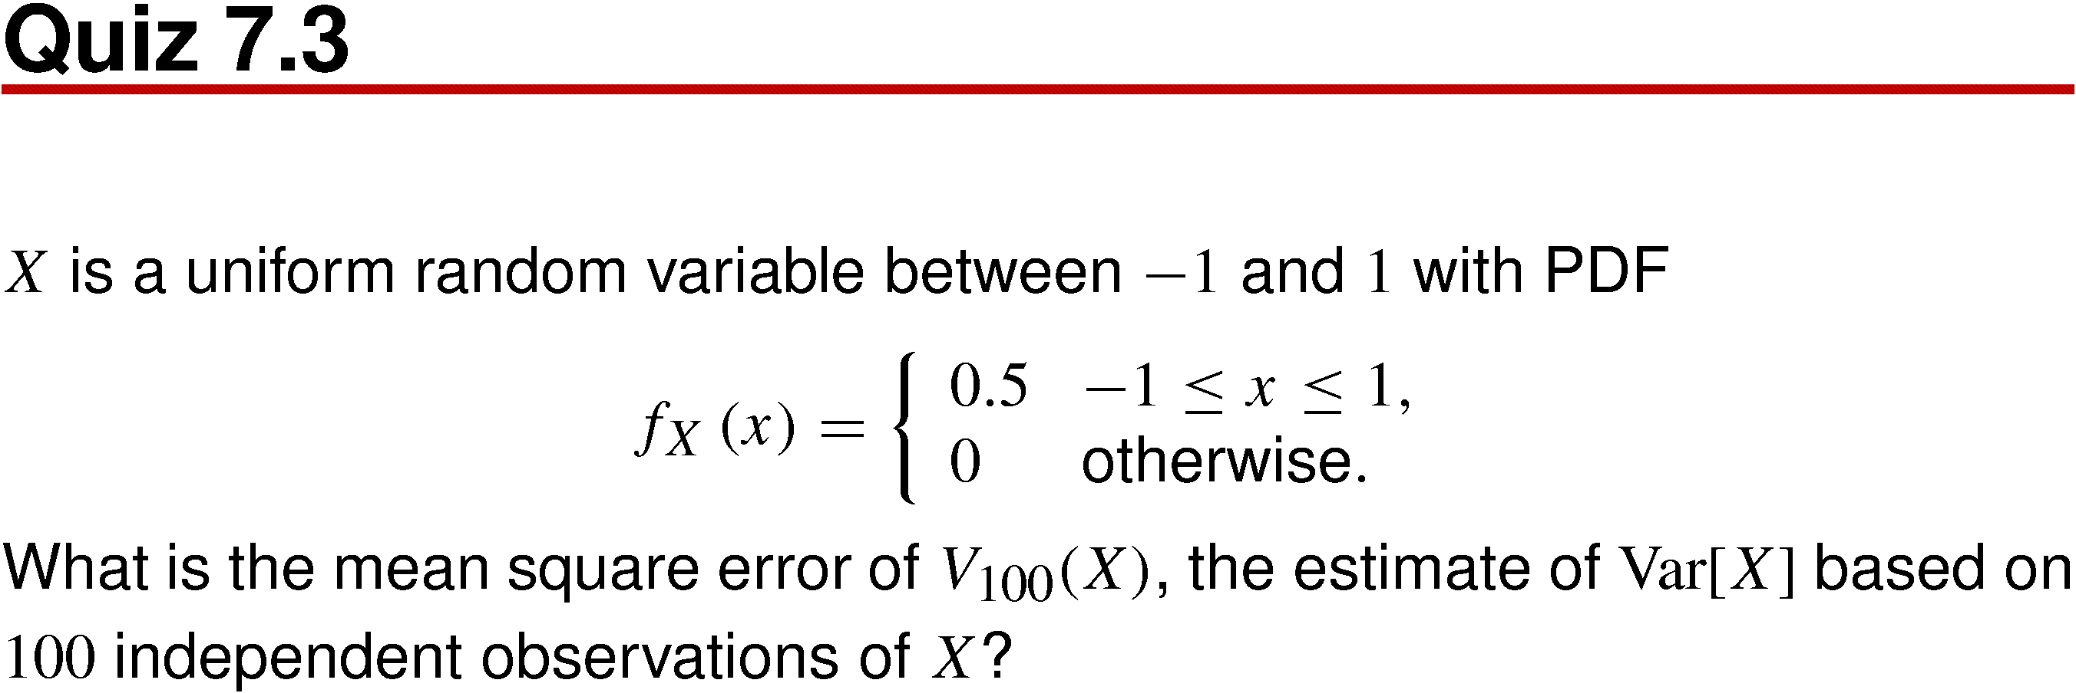
Quiz 7.3

Slide 47
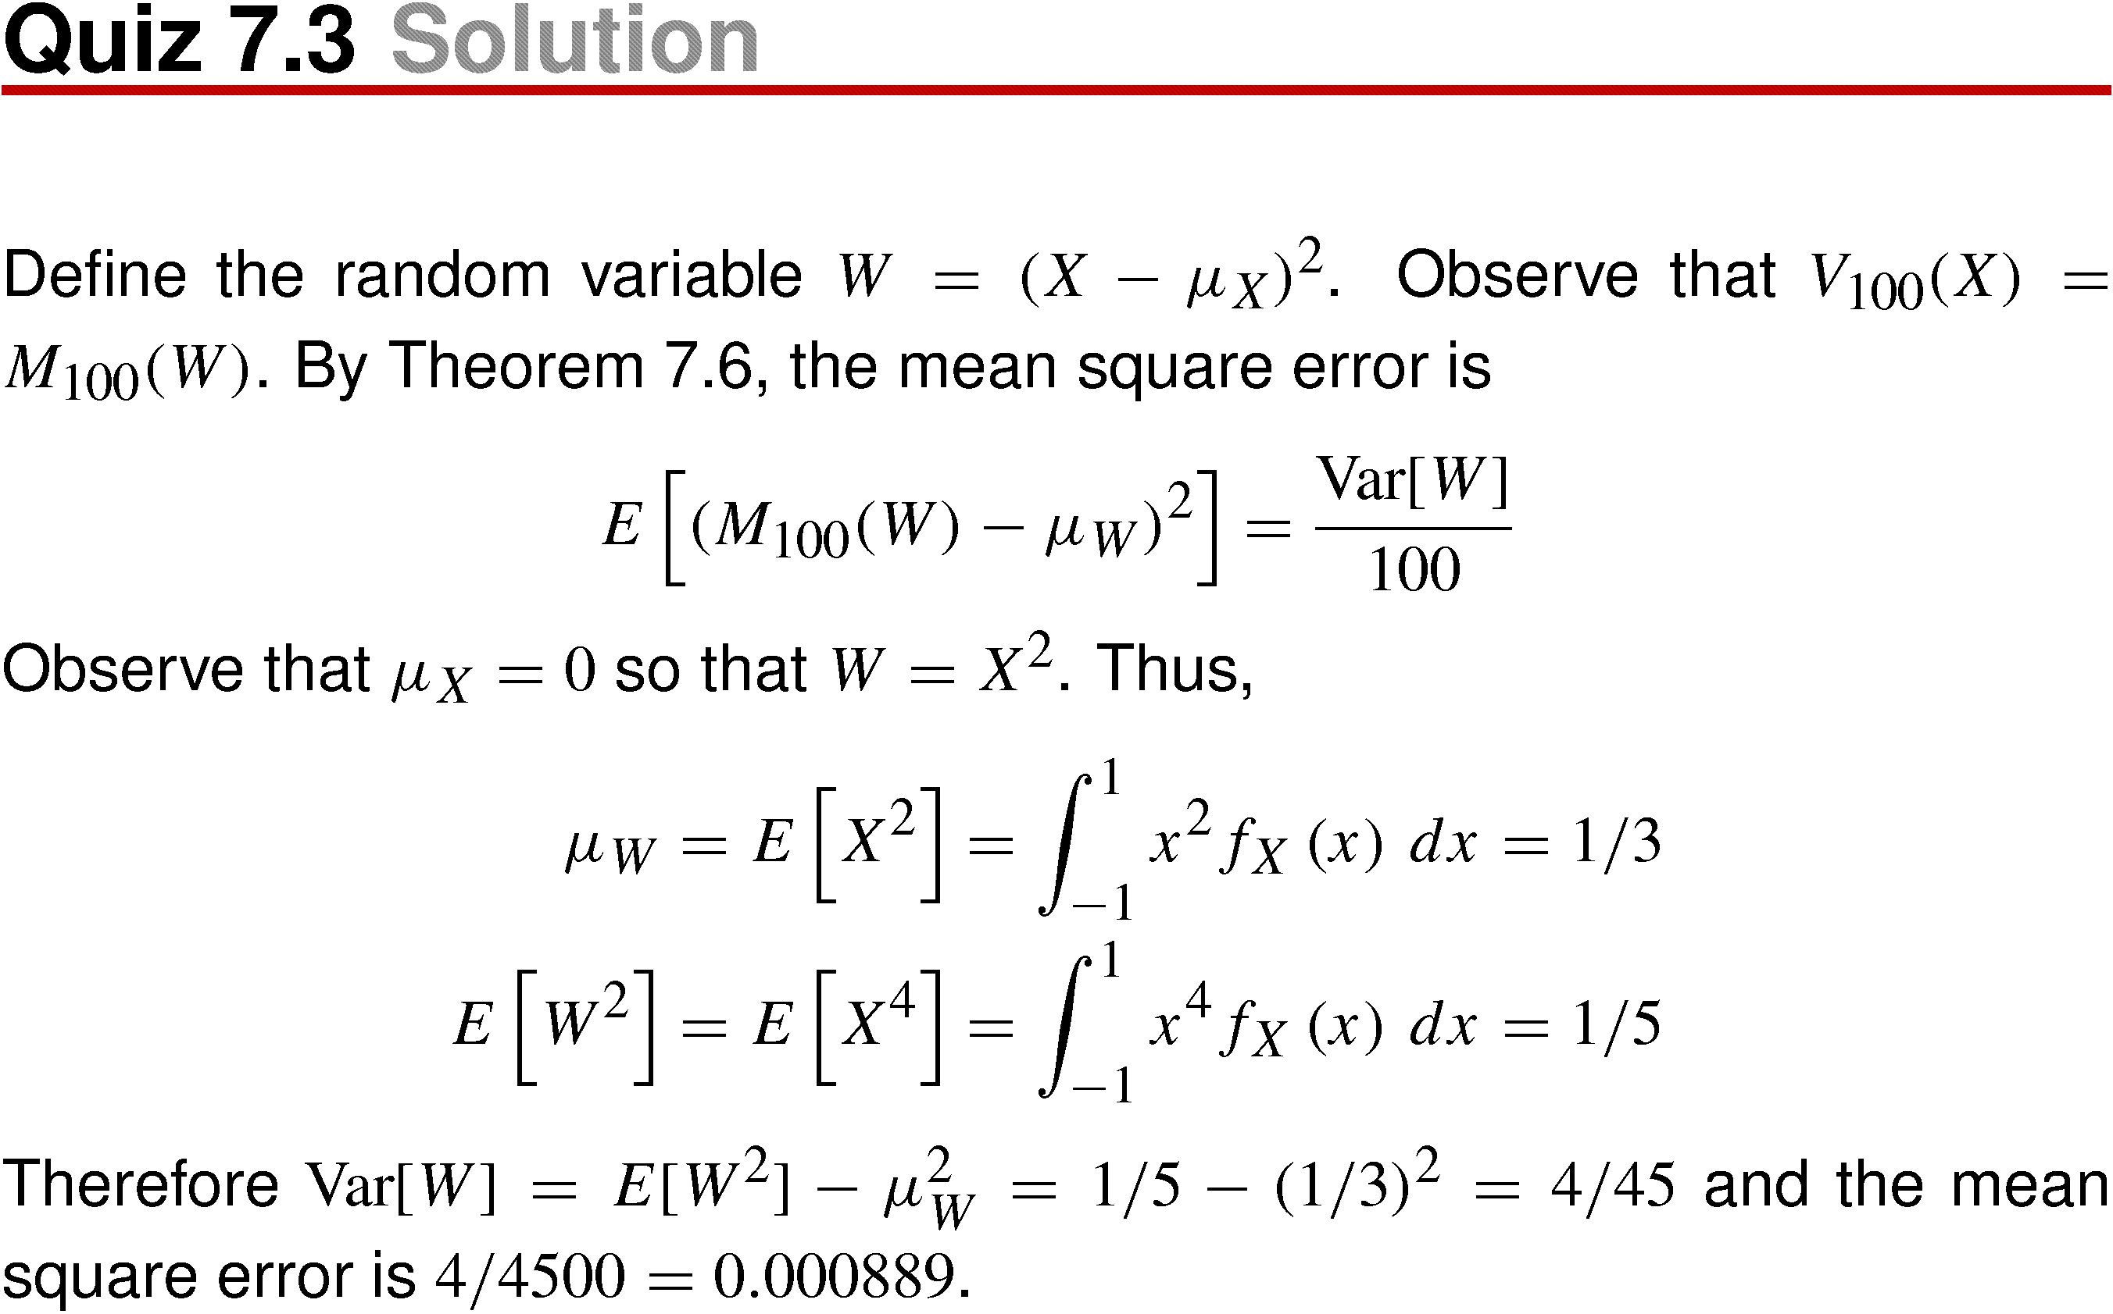
Quiz 7.3 Solution

Slide 48
7.4 Confidence Intervals

Slide 49
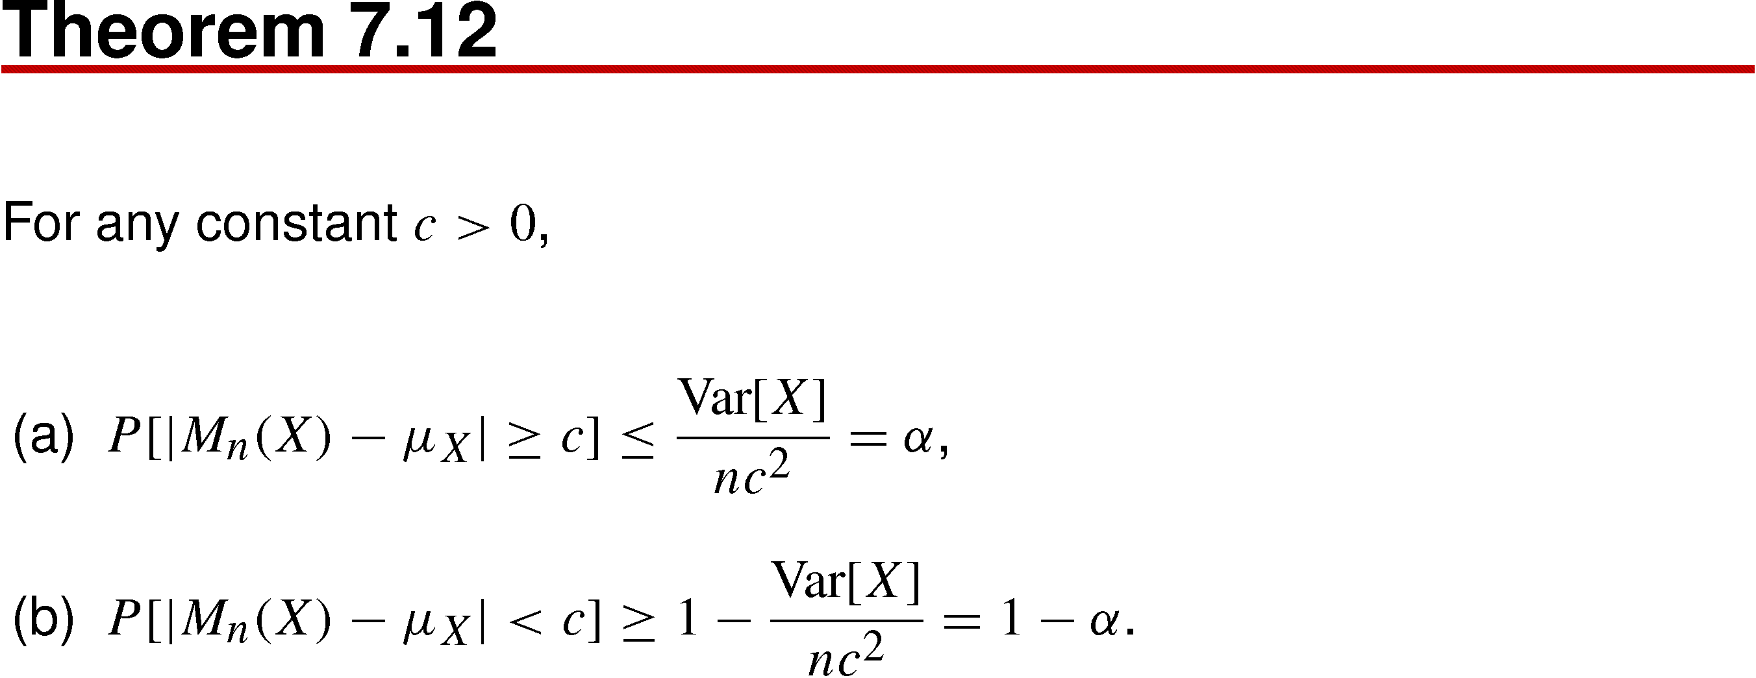
Theorem 7.12

Slide 50
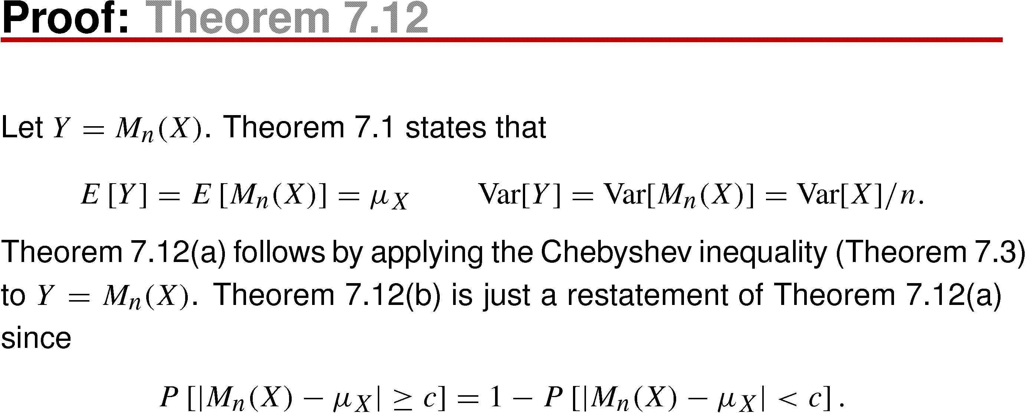
Theorem 7.12 Proof

Slide 51
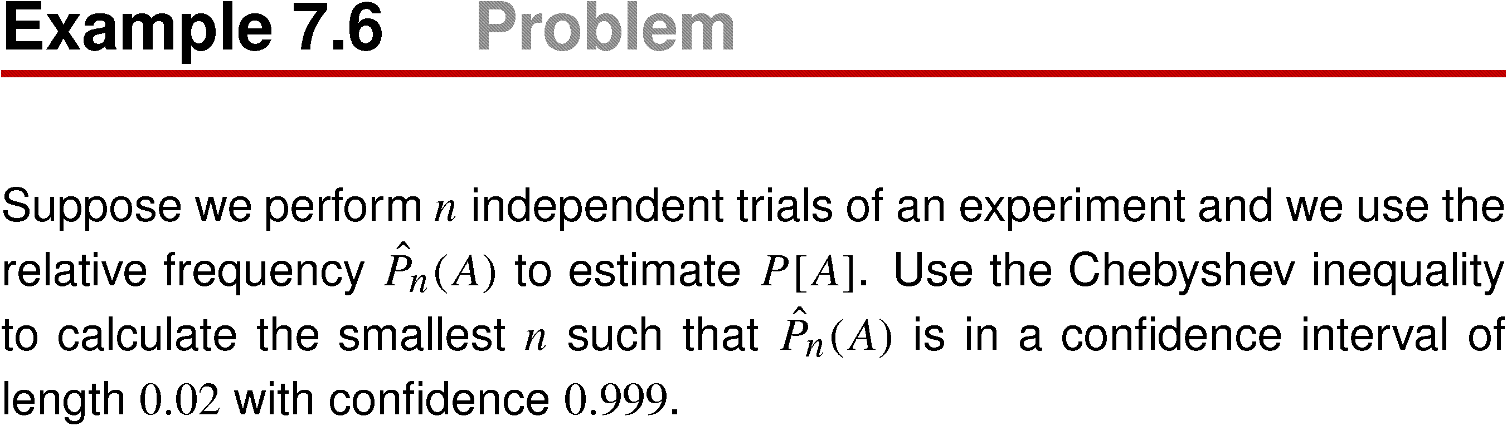
Example 7.6

Slide 52
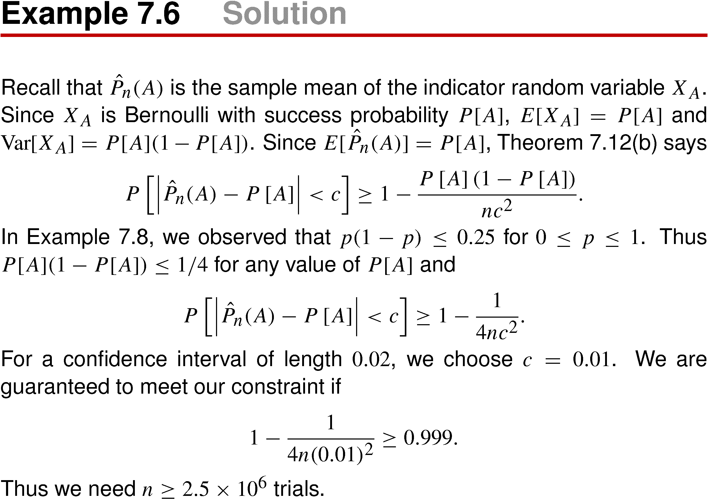
Example 7.6 Solution

Slide 53
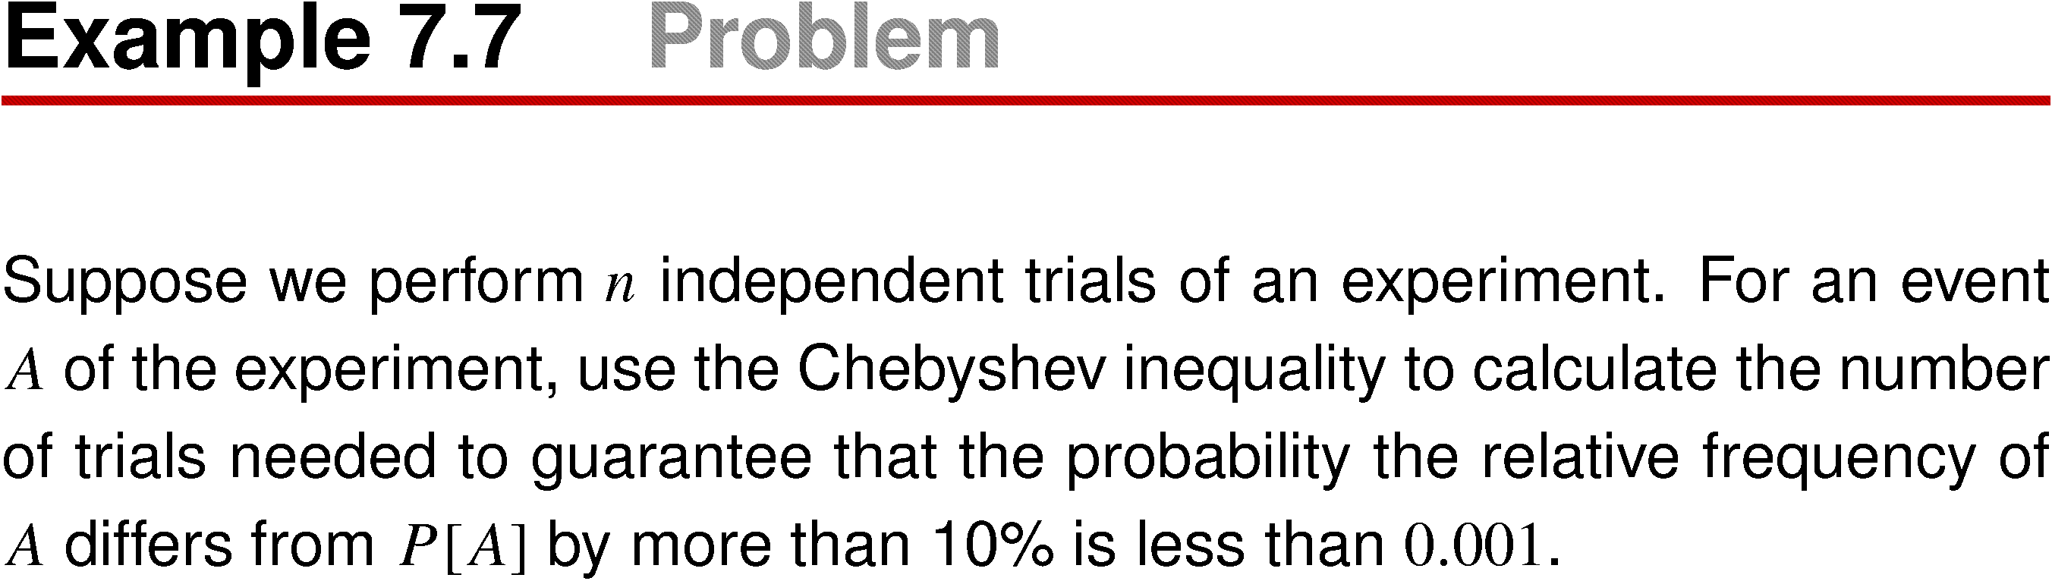
Example 7.7

Slide 54
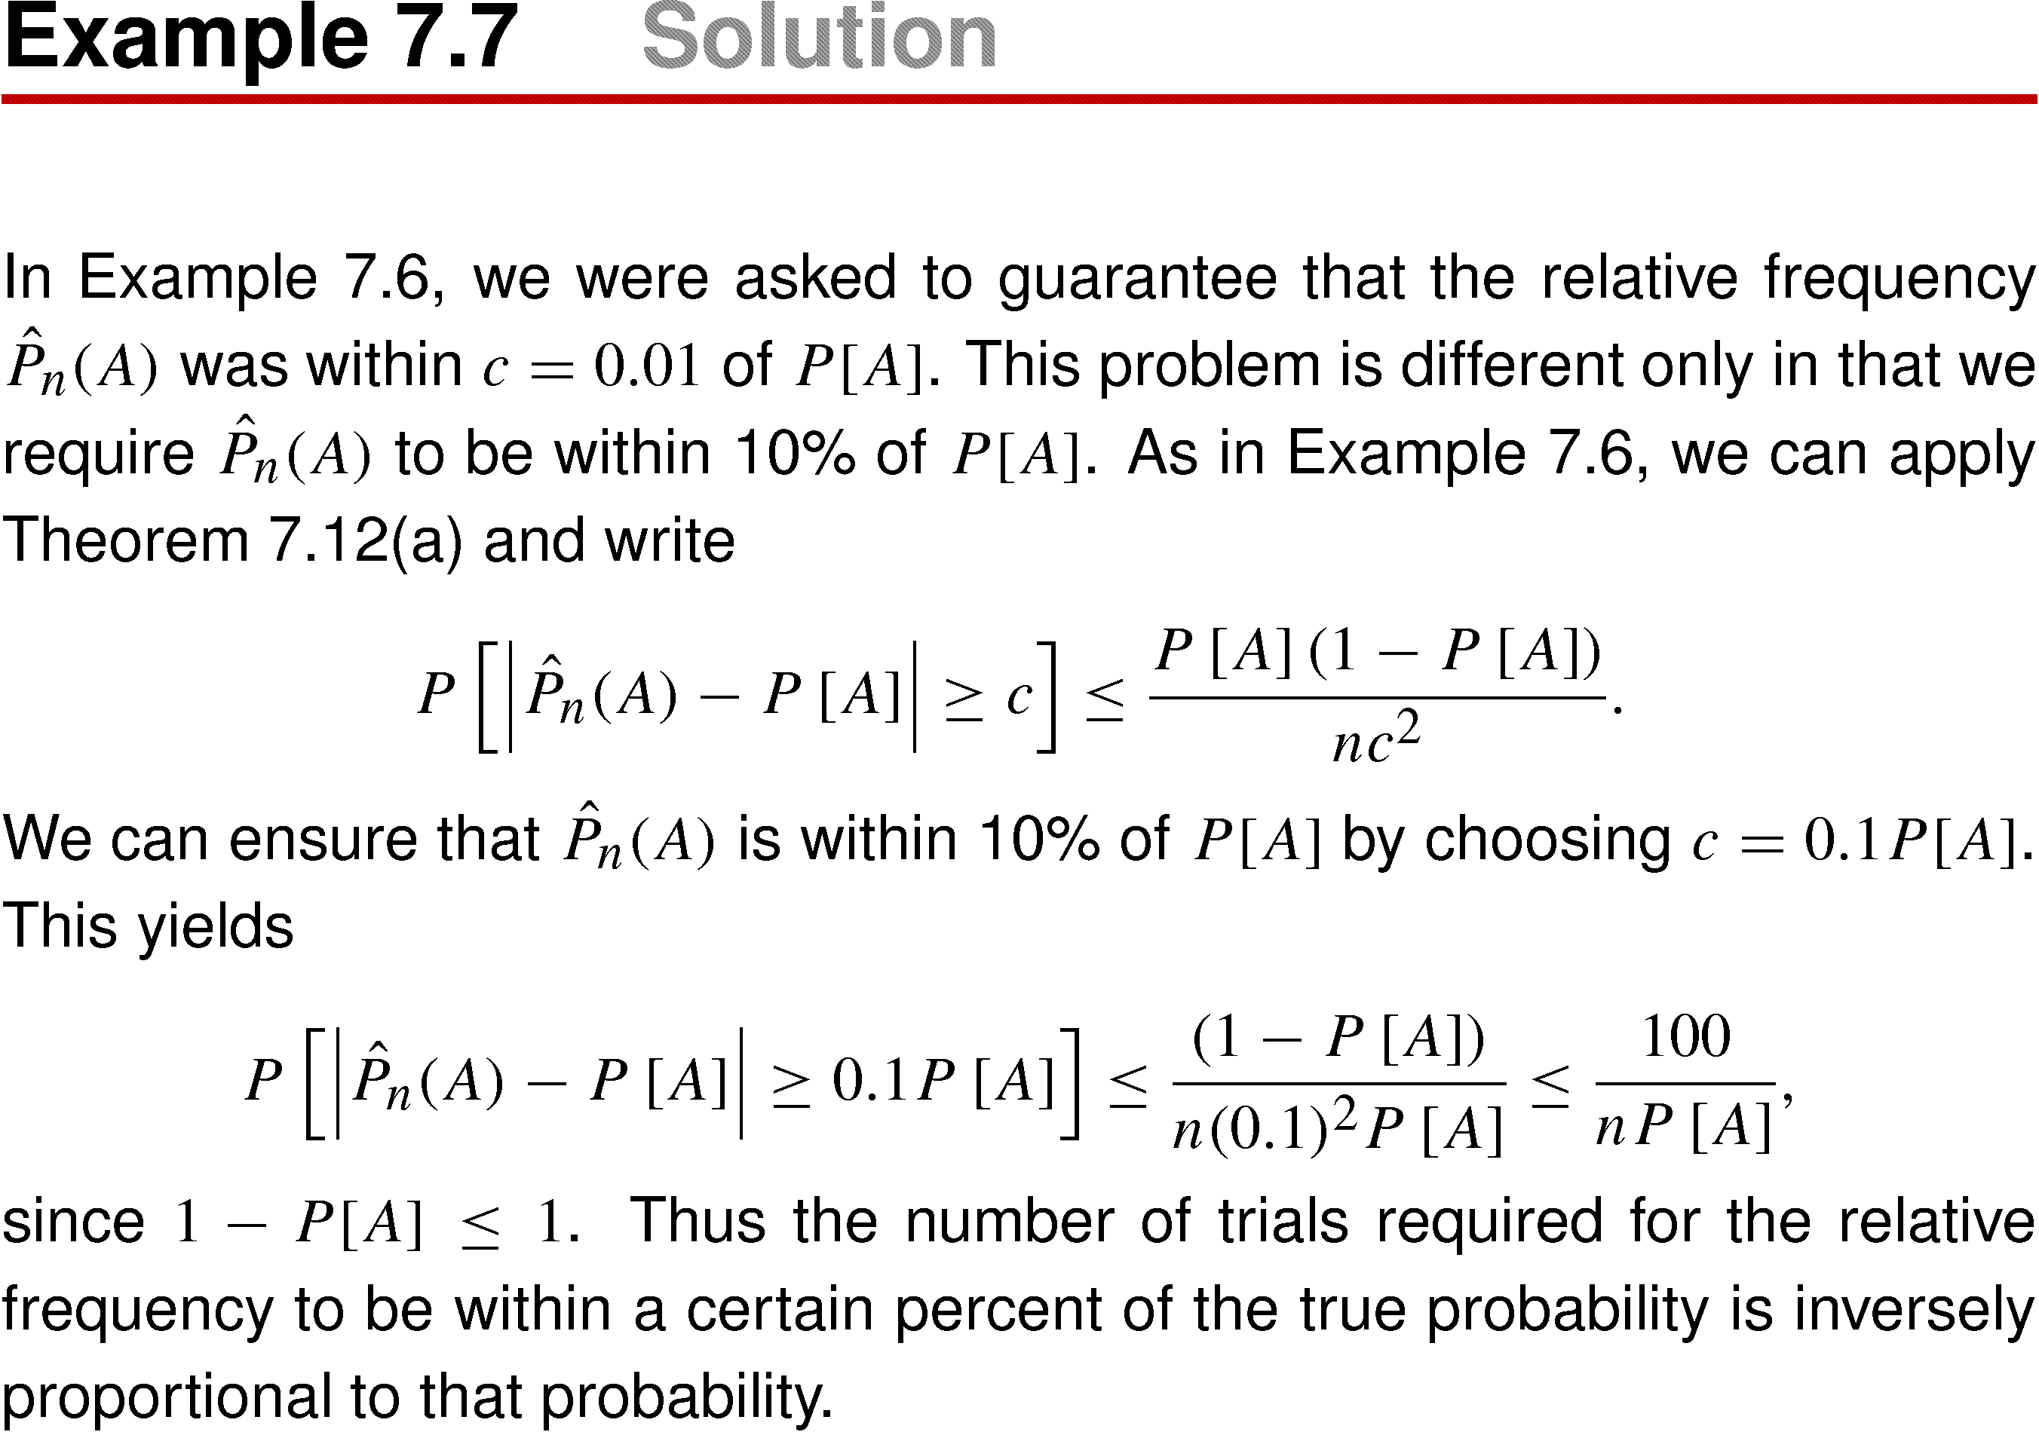
Example 7.7 Solution

Slide 55
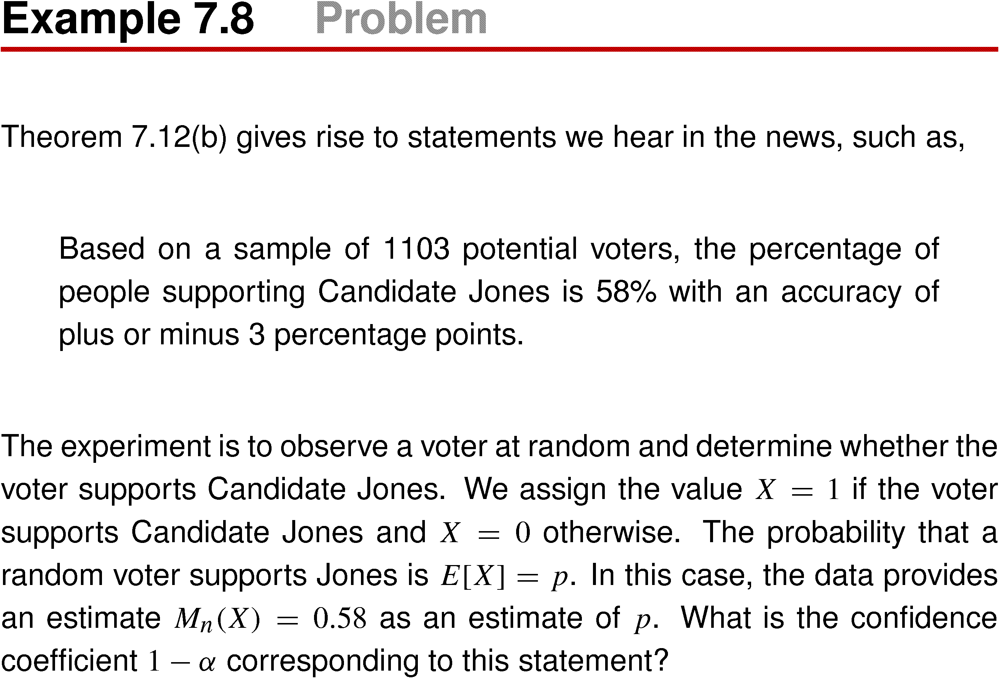
Example 7.8

Slide 56
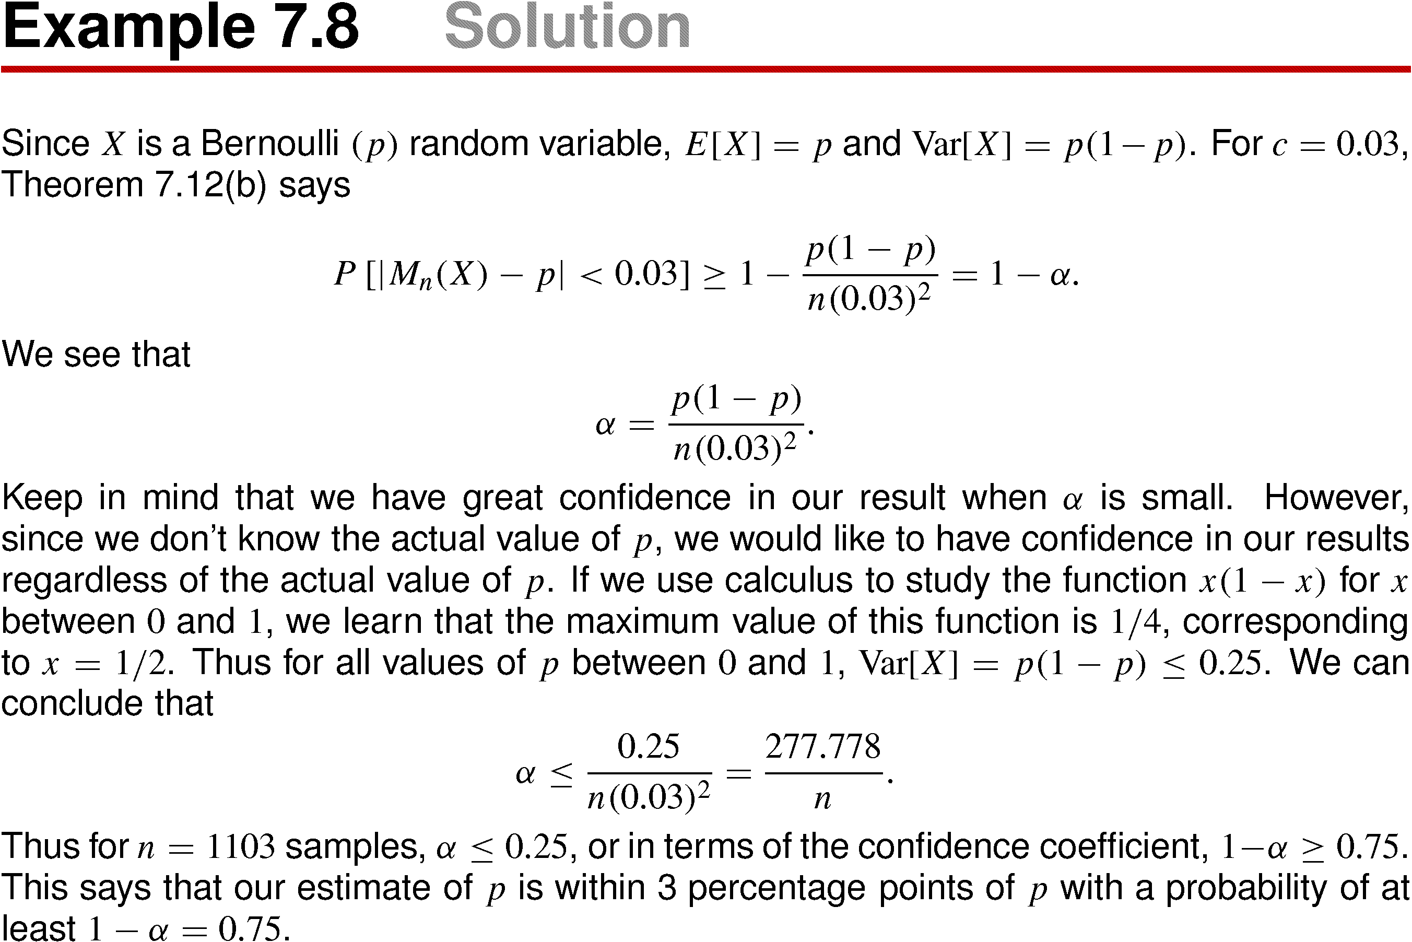
Example 7.8 Solution

Slide 57
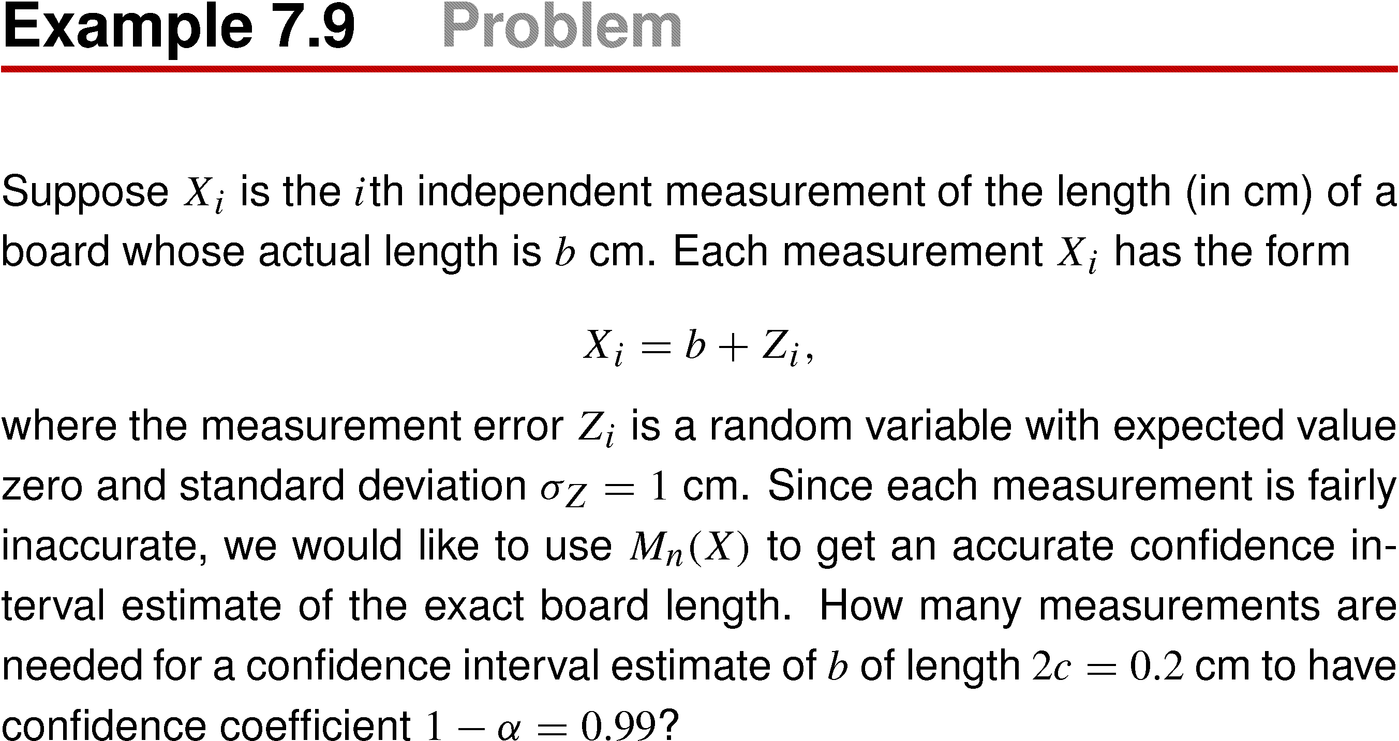
Example 7.9

Slide 58
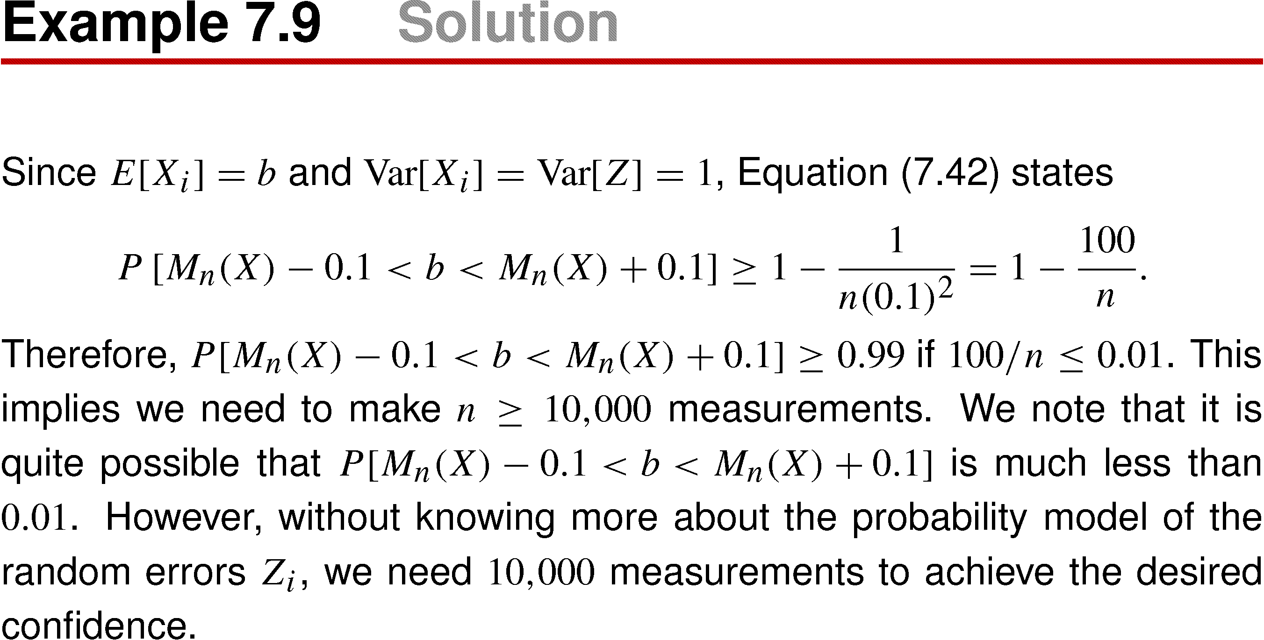
Example 7.9 Solution

Slide 59
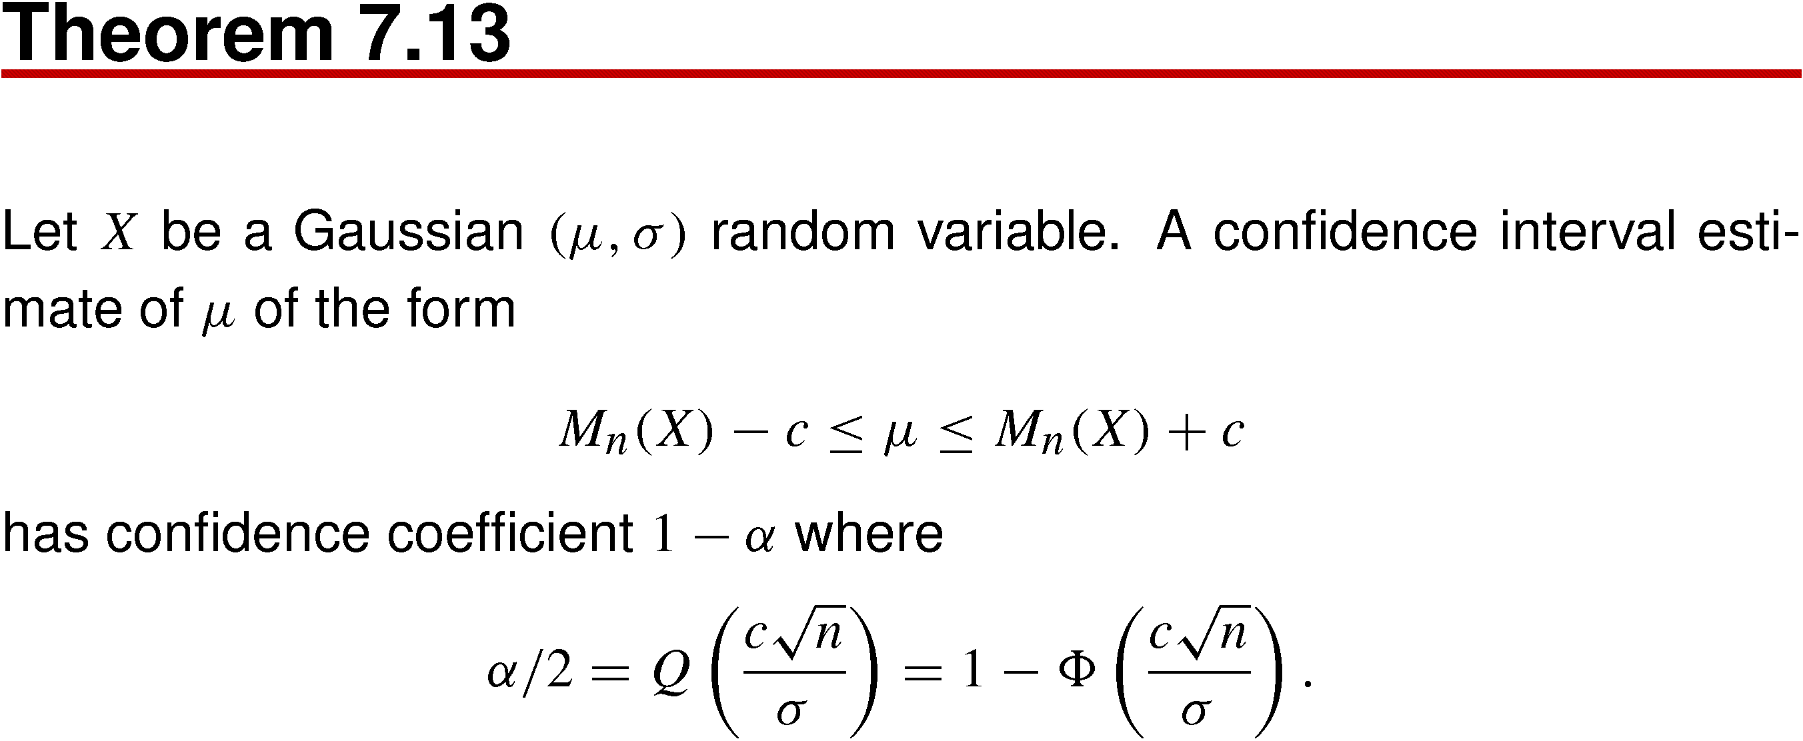
Theorem 7.13

Slide 60
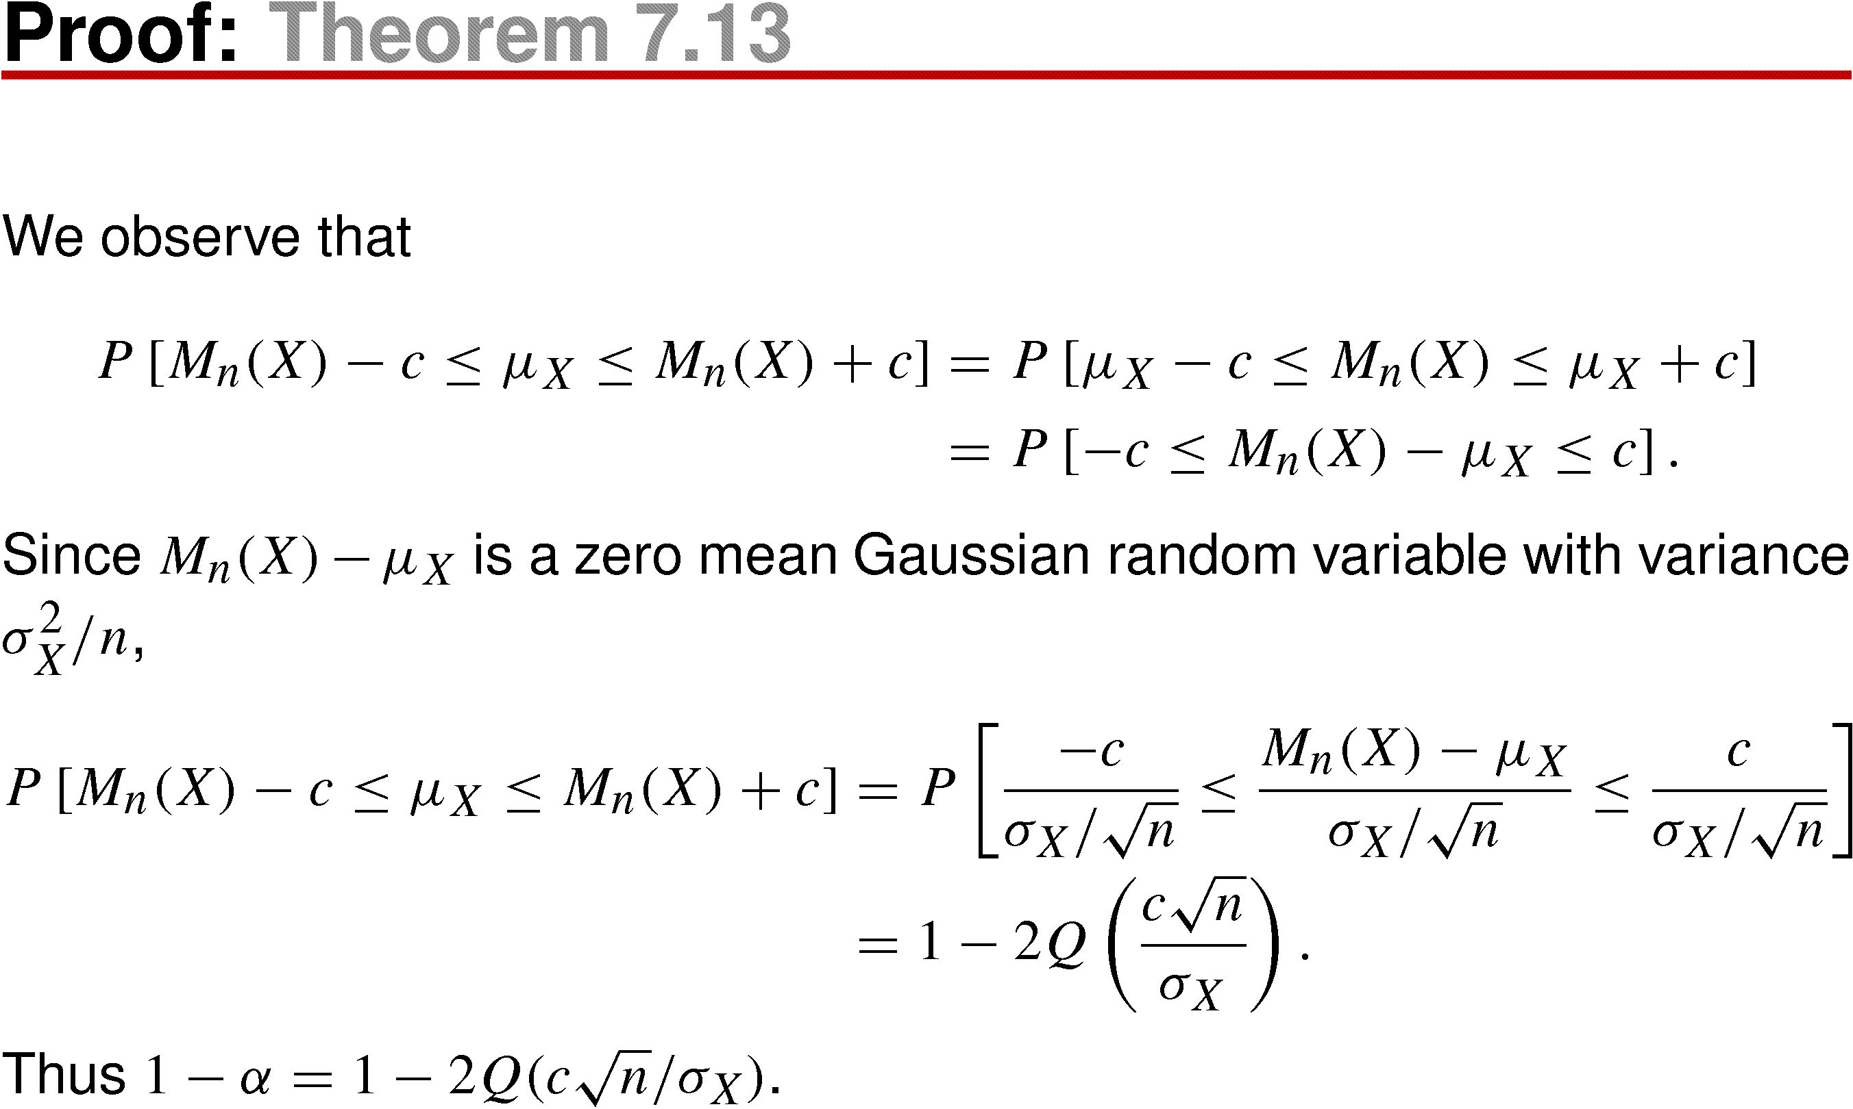
Theorem 7.13 Proof

Slide 61

Example 7.10

Slide 62

Example 7.10 Solution

Slide 63

Example 7.11

Slide 64

Example 7.11 Solution

Slide 65

Quiz 7.4

Slide 66

Quiz 7.4 Solution

